Slide 1
Monthly Nurse Safe Staffing
Sponsoring executive director: Lorraine Szeremeta, Chief Nurse
Amanda Small, Deputy Chief Nurse
Christopher Gray, Lead Nurse Safer Staffing
Sarah Raper, Project Lead Nurse safe staffing
Board of Directors: 17 April 2024

Slide 2
Executive Summary
This slide set provides an overview of the Nursing and Midwifery staffing position for February 2024.
The vacancy position in February has remained relatively static for Registered Children’s Nurses (RSCNs) at 20.6% (20.8% in January), Registered Midwives (RMs) at 0.36% (-0.8% in January) and Maternity Care Assistants (MCAs) at 10.7% (10.3% in January). There has been a reduction in the vacancy rate for Registered Nurses (RNs) to 7.7% from 9.2% in January and Health Care Support Workers (HCSWs) to 13.8% from 14.8% in January. The turnover rate in February remains high but is relatively static in all areas with HCSW (including MCAs) at 15.2% (15.1% in January), RNs at 10% (10.2% in January), RMs at 12% (12.3% in January) and RSCN’s at 14.5% (14.9% in January). The main reason for leaving for all staff groups is voluntary resignation – relocation. The leavers destination data demonstrates that 29.5% of RNs and 36.4% of RMs are leaving to take up employment in other NHS organisations. 21.2% of RMs are leaving for no employment compared to 9.5% of RNs. Conversely, the leavers destination is unknown for the majority of HCSWs (45%) and 11.5% are leaving for no employment.
The planned versus actual staffing report demonstrates that 11 clinical areas reported <90% overall rota fill in February (12 in January). The overall fill rate for maternity has increased to 98.2% compared to 92.1% in January. The total unavailability of the workforce working time in January has decreased by 0.1%% to 28.4%. The majority of unavailability (14.9%) is due to planned annual leave. Sickness absence has decreased slightly in February to 6.8% (7.4% in January). Additionally, 1.3% of working time was unavailable due to other leave, 3.5% was due to study leave and 1.9% was due to supernumerary time. Any decrease in fill rate within midwifery is mitigated through acuity assessment and redeployment of non-clinical, managerial and specialist staff to cover gaps. Where safety concerns arise the escalation to divert policy is activated to balance risk and maintain safety. During these incidences 1:1 midwifery care is maintained, and supernumerary status of the coordinator is a priority.
In order to mitigate staffing risks, the number of requests for bank workers remains high with an average of 2515 shifts per week requested for registered staff and 2344 shifts requested for Health care support workers and Maternity support workers per week with an average bank fill rate of 78% for registered staff and 61.28% for Health Care Support workers. In addition, the equivalent of 15.8 WTE agency workers are working across the divisions (15.79 WTE in January). Despite this, redeployment of nurses and midwives has remained necessary due to staff unavailability, with an average of 300 working hours being redeployed each day.
The number of occasions that 1 critical care nurse has needed to care for more than 1 level 3 patient has decreased in February to 14 occasions compared to 26 in January. Additionally, there have been 77 occasions in February where there has been no side room coordinator (113 in January). Any concerns with regards to critical care staffing are escalated through the senior nurse of the day. Staffing has been supported through the use of temporary workers (agency and bank), enhanced bank rates and registered staff (non critical care trained) are redeployed from the operational pool and clinical areas on a shift-by-shift basis. Critical care have opened 3 of the beds that were closed due to staffing resulting in 55 open beds rather than 59 beds. Recruitment is ongoing to the vacant positions with a plan to open the remaining 4 beds when vacancy allows.

Slide 3
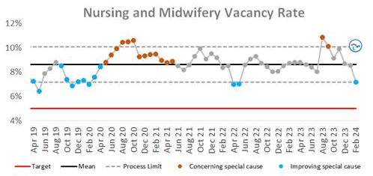
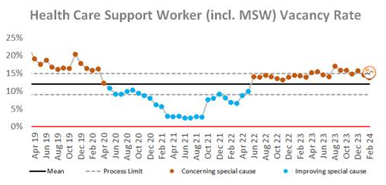
Combined Nursing and Midwifery Staffing Position Vacancy Rates
Graph 1. Nursing and midwifery vacancy rates
Vacancy position
The combined vacancy rate for Registered Nurses (RNs) and Registered Midwives (RMs) has decreased to 7.2% in February from 8.5% in January. The vacancy rate for Health care support workers (HCSWs) including Maternity Care Assistants (MCAs) has decreased to 13.8% in February (14.6% in January). When broken down further into Nursing and Midwifery specific vacancies, the MCA workforce vacancy rate has increased slightly to 10.7% from 10.3% in January. The HCSW vacancy rate (excl MCA) has decreased to 13.8% from 14.8% in January.
The HCSW (including MCAs) turnover rate remains high at 15.2% (15.1% in January). The main reason for HCSWs leaving is voluntary resignation – relocation (31.4%) and the next highest reason is voluntary resignation – work life balance (24.6%). The leavers destination is unknown for the majority of HCSWs (45%), 15.2% of HCSWs are leaving to take up employment in other NHS organisations and 11.5% are leaving for no employment.
Graph 2. Healthcare Assistant vacancy rates

Slide 4
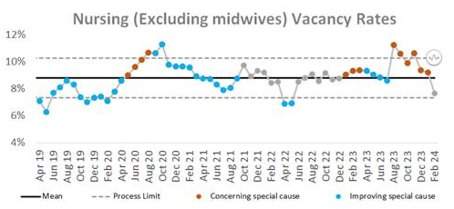
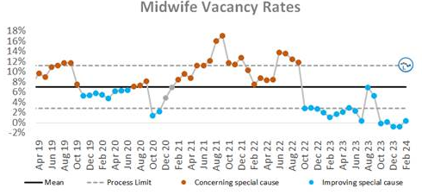
Staffing Position Vacancy Rates for Registered Nurses and Registered Midwives
Graph 3. Registered Nurse vacancy rates
Vacancy position
The vacancy rate for RNs working in adult areas has decreased to 7.7% in February (9.2% in January) as illustrated in Graph 3. The vacancy rate for registered children's nurses has remained relatively static at 20.8% (20.6% in January).
The vacancy rate for Registered Midwives has increased slightly to 0.36% in February compared to -0.8% in January illustrated in Graph 4.
The turnover rate in February remains high, 10% for RNs in adult areas (10.2% in January), 12% for RMs (12.3% in January) and 14.5% registered children's nurses (14.9% in January). The main reasons for RMs leaving is voluntary resignation – relocation (33.3%) and the next highest reason is voluntary resignation – work life balance (21.2%). The main reason for RNs leaving is voluntary resignation – relocation (40.9%). The leavers destination data demonstrates that 29.5% of RNs and 36.4% of RMs are leaving to take up employment in other NHS organisations. 21.2% of RMs are leaving for no employment compared with 9.5% of RNs.
Graph 4. Registered Midwife vacancy rates

Slide 5
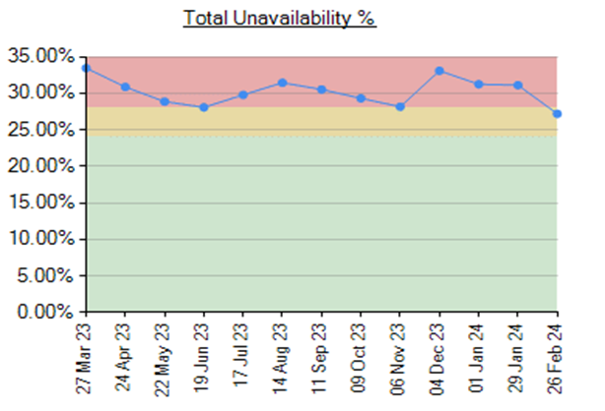
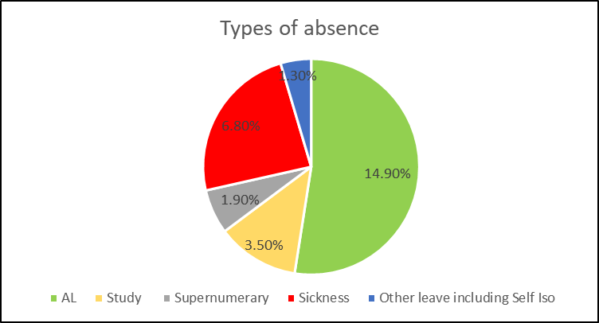
Unavailability for Registered Nurses, Midwives and Health Care Support Workers
Graph 5. Unavailability of staff
Unavailability of staff
Unavailability relates to periods of time where an employee has been given leave from their regular duties. This might be due to circumstances such as annual leave, sick leave, study leave, carers leave etc.
The total unavailability of the workforce working time in February has decreased by 0.1% to 28.4% as illustrated in Graph 5.
Graph 6 illustrates the percentage breakdown of the type of unavailability. The majority of unavailability (14.9%) was due to planned annual leave which would have been accounted for in the department rosters. There was a high percentage of unplanned leave that would have impacted upon fill rates within the rosters. In February, sickness absence has remained high but has slightly decreased to 6.8% from 7.4% in January. Supernumerary has reduced to 1.9%, study leave has remained at 3.5% however, other leave has increased to 1.3%.
Graph 6. Types of absence

Slide 6
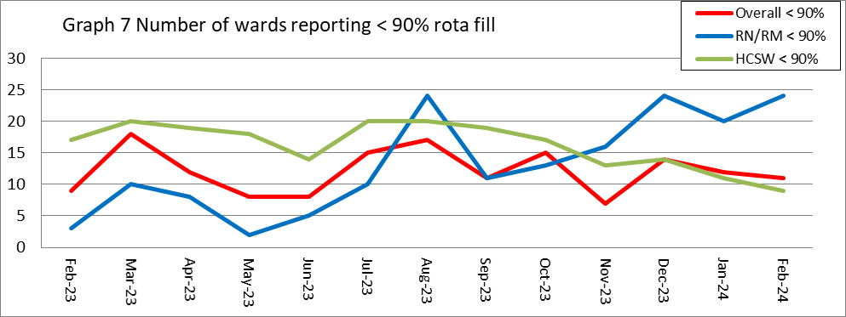
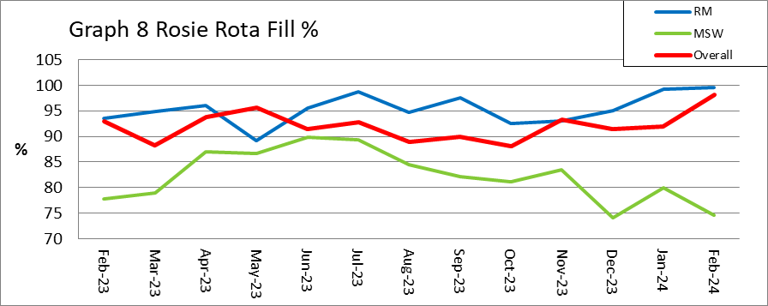
Planned versus actual staffing
Planned versus actual staffing
Graph 7 illustrates trend data for all wards reporting < 90% rota fill. The number of areas reporting <90% rota fill for registered RN/RM has increased to 24 in February from 20 in January. The number of areas reporting <90% rota fill for HCSWs in February has decreased to 9 from 11 in January. The number of ward areas reporting overall fill rates of <90% in February has decreased to 11 compared to 12 in January. Appendix 1. details the exception reports for all areas reporting RN/RM fill rates of <90%.
The number of occasions that 1 critical care nurse has needed to care for more than 1 level 3 patient has decreased in February to 14 occasions compared to 26 in January. Additionally, there have been 77 occasions where there has been no side room coordinator (113 in January). Any concerns with regards to critical care staffing is escalated through the senior nurse of the day. Staffing has been supported through the use of temporary workers (agency and bank) and registered staff (non critical care trained) are redeployed from the operational pool and clinical areas on a shift-by-shift basis. There was also short-term agreement to pay critical care trained staff bank enhancement to reduce the over all amount of GPICS breaches. Critical care have opened 3 of the beds that were closed due to staffing resulting in 55 open beds rather than 59 beds. Recruitment is ongoing to the vacant positions with a plan to open the remaining 4 beds when vacancy allows.
Midwifery & MSW fill rate
Graph 8 illustrates that the overall fill rate for maternity has increased to 98.2% in February form 92% in January which is higher than the 12-month average of 92.1%. The lowest fill rates have been seen on Lady Mary Ward (88%). Mitigated through redeployment of staff where required to meet acuity needs.

Slide 7
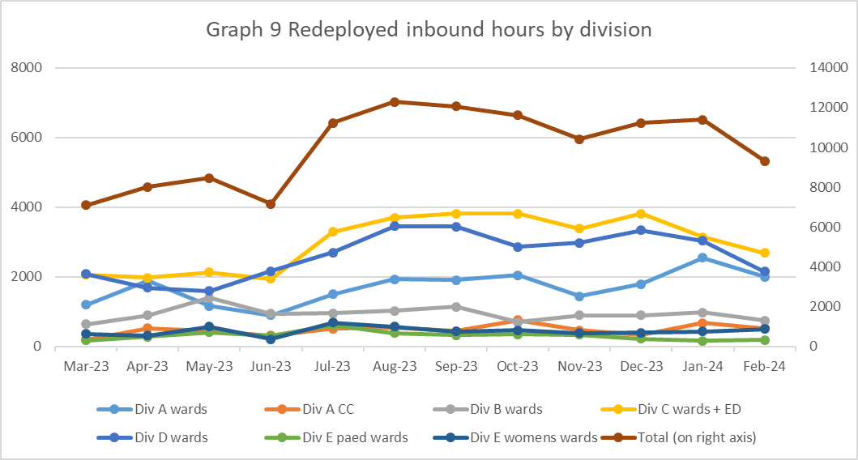
Staff deployment
Staff deployment
Graph 9 illustrates the movement of staff across wards to support safe staffing to ensure patient safety. This includes staff who are moved on an ad hoc basis (shift by shift) and shows which division they are deployed to.
The number of substantive staff redeployed has decreased in February with 300 working hours being redeployed per day in February (367.5 hours in January). This equates to 26.11 long day or night shifts per day. Staffing is also being supported by the operational pool whereby bank staff book a bank shift on the understanding that they will work anywhere in the trust where support is required.
Nursing Pipeline
Appendix 2 provides detail on the forecasted position in relation to the number of adult RN vacancies based on FTE and includes UK experienced, UK newly qualified, apprenticeship route, EU and international up to March 2025. The current forecast demonstrates a year end band 5 RN vacancy position of 1.6% which exceeds the target of 5%. The RN adult pipeline for 2024/25 now reflects the reduction in international recruitment. This is a national concern and has been escalated to NHS England. Work is being undertaken to explore RN Recruitment initiatives including increasing the International Recruitment pay band and reviewing our shortlisting criteria.
Appendix 3 provides detail on the forecasted position in relation to the number of Paediatric band 5 RN up to March 2025. Numbers are based on those interviewed and offered positions in addition to planned campaigns. The current forecast demonstrates a year end band 5 Paediatric RN vacancy position of 20.97% the predicted year end March 2025 of 3.21%.
Appendix 4 provides detail on the forecasted position in relation to number of HCSW vacancies up to March 2025. The predicted year end vacancy rate is 13.3%. Due to some HCSWs being moved over to Band 3 HCSW position numbers prior to 01 February this has caused some discrepancies in the ESR data leading to an increased vacancy rate with this amalgamation, however our intention is to mitigate any increase by centralising all band 3 HCSW vacancies. The predicted year vacancy at end March 2025 is 0.9%.
Whilst the recruitment pipeline is positive with multiple pipelines including apprenticeship routes, domestic and international recruitment, the predicted numbers are only achievable if the appropriate infrastructure is in place to support.

Slide 8
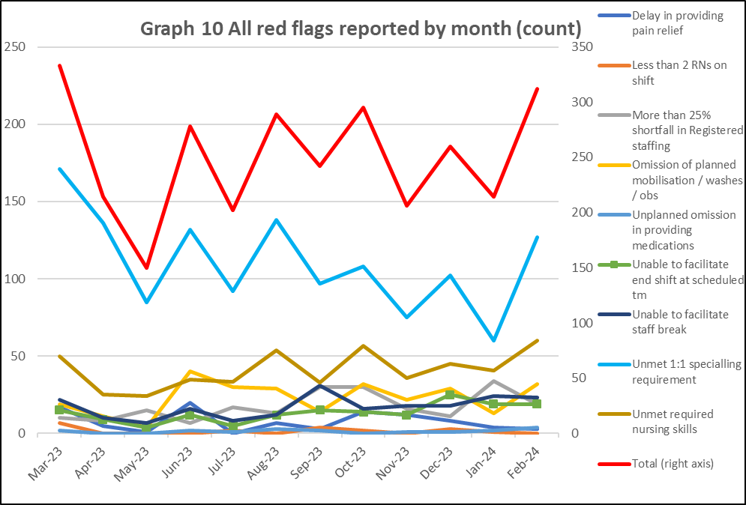
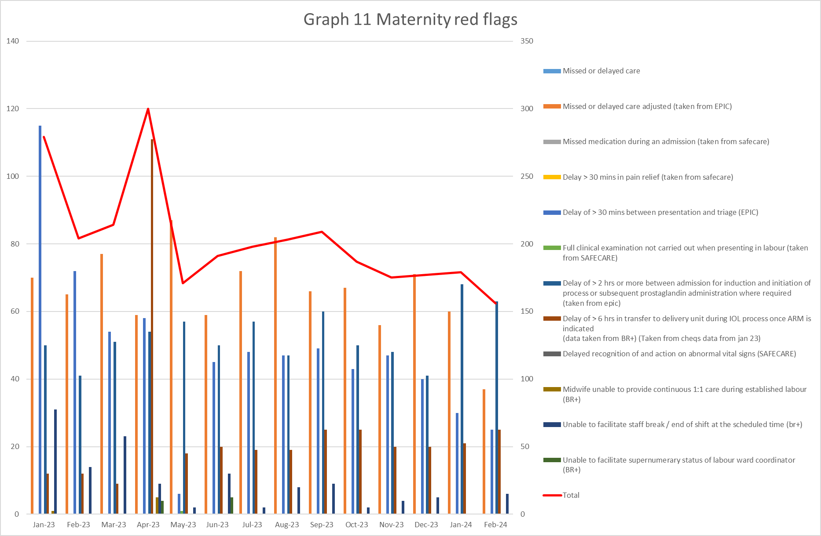
Red flags
Red Flags
A staffing red flag event is a warning sign that something may be wrong with nursing or midwifery staffing. If a staffing red flag event occurs, the registered nurse or midwife in charge of the service should be notified and necessary action taken to resolve the situation.
Nursing red flags
Graph 10 illustrates that there has been an increase in the number of red flags reported with 312 reported in February. The highest number of red flags reported in February was in relation to an unmet 1:1 specialling requirement (127 compared with 60 in January). A trust wide improvement project focusing on specialling is being developed to review specialling across the organisation. There has been an increase in 2 reportable red flags in February with the remaining all reducing. The increase was seen in omission of planned mobilisation/washes/obs and unplanned omission in providing medications.
Maternity red flags
The number of maternity red flags has decreased slightly from 179 in January to 156 in February. Graph 11 illustrates the red flags that have been reported with the highest reported being Delay of >2hours or more between admission for induction and initiation of process or subsequent prostaglandin administration where required (40% in February 38% in January). 2 other red flags have also increased Delay >6 hours in transfer to delivery unit during induction of labour (16% in February 11.7% in January) and unable to facilitate staff break (3.8% in February 0% in January). All other red flags have seen a reduction. High numbers of unresolved red flags that cannot be mitigated will trigger escalation to divert policy with actions including:- redeployment of staff to higher acuity areas, seeking support from system for elective work such as caesarean sections and inductions of labour.

Slide 9
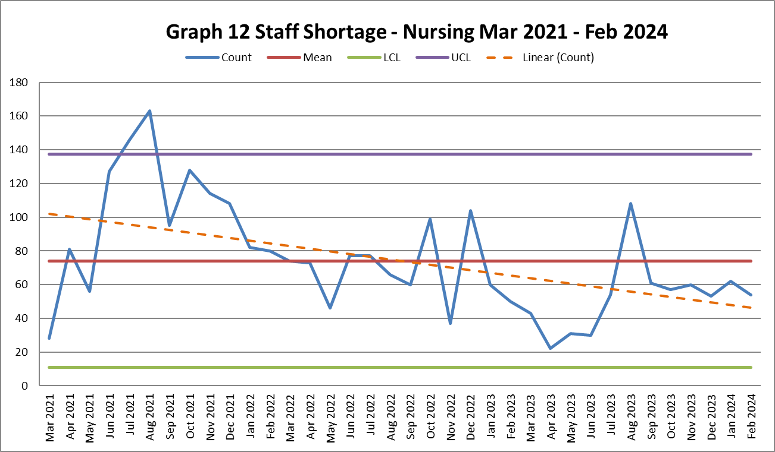
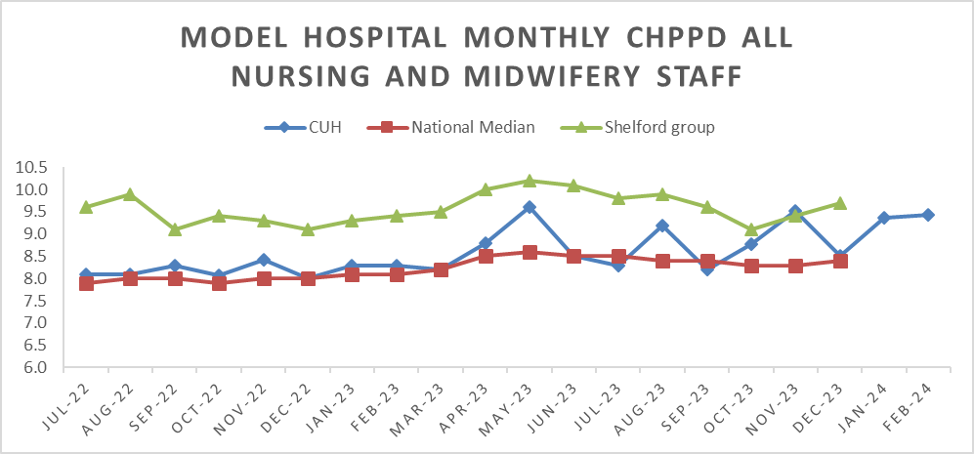
Safety and Risk
Incidents reported relating to staff shortages
Graph 12 illustrates the trend in Safety Learning Reports (SLRs) completed in relation to nurse staffing. In February there were 54 incidents reported compared to 62 in January.
The majority of the incidents related to staffing levels in February were reported by division D with 19. The highest reporting area being Ward D7 (10).
Care hours per patient day (CHPPD)
Care hours per patient day (CHPPD) is the total number of hours worked on the roster (clinical staff including AHPs) divided by the bed state captured at 23.59 each day. NHS Improvement began collecting care hours per patient day formally in May 2016 as part of the Carter Programme. All Trusts are required to report this figure externally.
CUH CHPPD recorded for February has increased to 9.43 from 9.36 in January however this remains below other Shelford hospitals (9.6).
In maternity, from 1 April 2021, the total number of patients now includes babies in addition to transitional care areas and mothers who are registered as a patient. CHPPD for the delivery unit in January has decreased to 16.51 (18.04 in January).
Graph 13: Care Hours Per Patient Day (CHPPD)

Slide 10
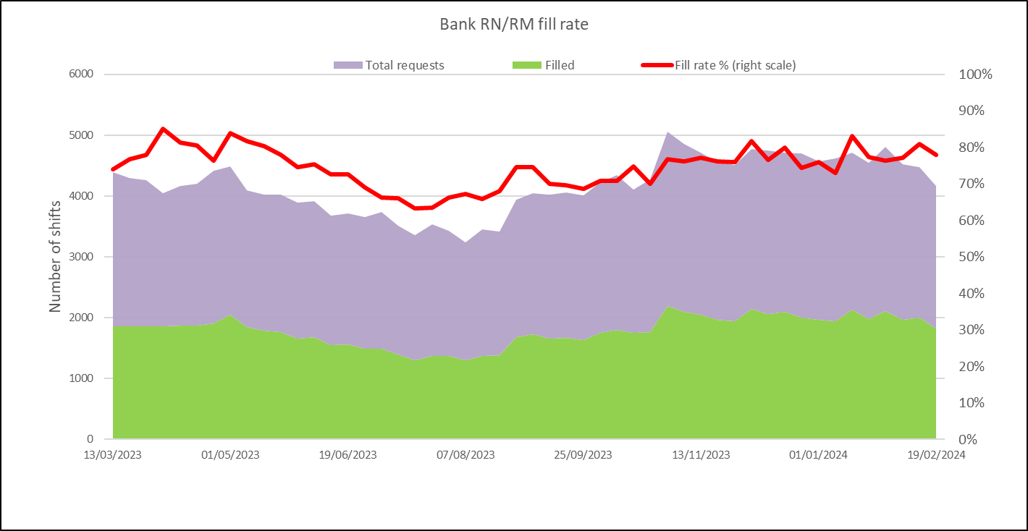
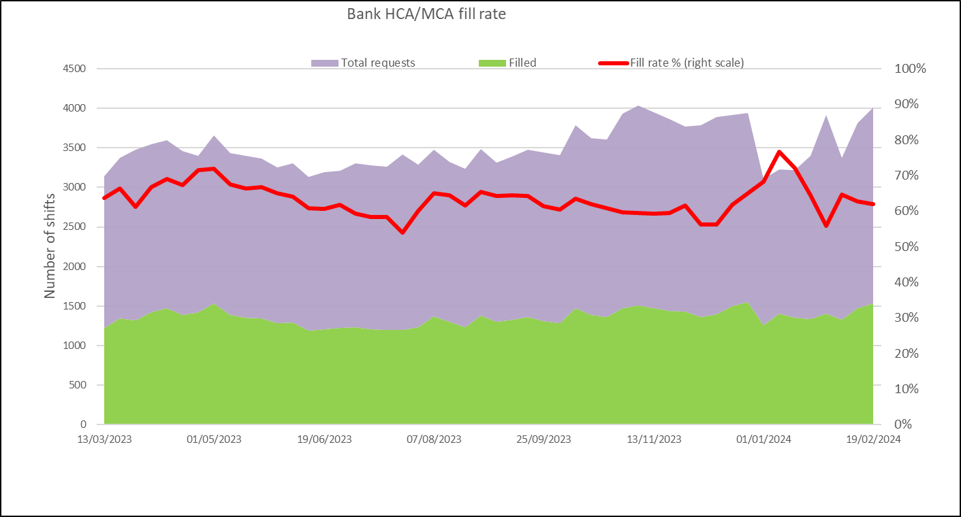
Bank Fill Rate and Agency Usage
Graph 14 Registered RN/RM Bank fill rate per week
Bank fill rate
The Trust’s Staff Bank continues to support the clinical areas with achieving safe staffing levels. Graph 14 and 15 illustrate the trends in bank shift fill rate per week. Overall, we continued to see an increase in February for bank shift requests for registered staff to mitigate those areas who have less than a rota fill of 90% or to cover an unmet specialling need. The number of requests for registered staff is an average of 2515 shifts per week with an average bank fill rate of 78% which is a increase from 77.3% in January.
The number of requests for Health care support workers and Maternity support workers remains high with an average of 2344 shifts per week with an average bank fill rate of 61.28% this is an decrease from 70.36% in January.
In addition to bank workers, we have the equivalent of 15.8 WTE agency workers working (15.79 WTE in January) across the divisions to support staffing challenges in the short This agency usage had been reducing but to support the emergency department, critical care and opening additional beds within reconfiguration there has been a need to increase to support safe staffing.
Short term pay enhancements for bank shifts have been put in place to support staff being deployed. Any bank enhancements in place are reviewed regularly (at least on a 6-weekly basis) through the weekly bank enhancement meeting and are for fixed periods of time.
Graph 15 HCSW/MSW bank fill rate per week

Slide 11
Appendix 1: Exception report by Division

Slide 17
Appendix 2: Adult RN Recruitment pipeline

Slide 18
Appendix 3: Paediatric RN

Slide 19
Appendix 4: Band 2 HCSW Recruitment pipeline

