Slide 1
Monthly Nurse Safe Staffing
Sponsoring executive director: Lorraine Szeremeta, Chief Nurse
Amanda Small, Deputy Chief Nurse
Christopher Gray, Lead Nurse Safer Staffing
Sarah Raper, Project Lead Nurse safe staffing
Board of Directors: 14 February 2024

Slide 2
Executive Summary
This slide set provides an overview of the Nursing and Midwifery staffing position for December 2023.
The vacancy position in December for Health Care Support Workers (HCSWs) has increased slightly from 14.8% in November to 15.4%. In all other areas there has been a reduction in the vacancy rate. For Registered Nurses (RNs) the vacancy rate is 9.4% (10.6% in November), Registered Children’s Nurses (RSCNs) 18.7% (18.9% in November), Registered Midwives (RMs) -0.76% (0.14% in November) and Maternity Care Assistants (MCAs) 16.1% (19.3% in November). The turnover rate in December remains high but is relatively static in all areas, RSCNs 14.3% (14.2% in November), RNs 10.3% (10.4% in November), RMs 13.4% (13.5% in December) and HCSW (including MCA’s) 15.4% (15.8% in November). The main reason for leaving for all staff groups is voluntary resignation – relocation. The leavers destination data demonstrates that 27.3% of RNs and 35.1% of RMs are leaving to take up employment in other NHS organisations. 18.9% of RMs are leaving for no employment compared to 9.6% of RNs. Conversely, the leavers destination is unknown for the majority of HCSWs (46%).
The planned versus actual staffing report demonstrates that 14 clinical areas reported <90% overall rota fill in December (7 in November). The overall fill rate for maternity has decreased to 91.4% compared to 93.3% in November. The total unavailability of the workforce working time in December has decreased by 4.8% to 30.2%. The majority of unavailability (17.1%) is due to planned annual leave. Sickness absence has increased in December to 7.5% (7.0% in November). Additionally, 1.2% of working time was unavailable due to other leave, 2.5% was due to study leave and 1.90% was due to supernumerary time. While the overall fill rate in midwifery has dropped, this is mitigated through acuity assessment and redeployment of non-clinical, managerial and specialist staff to cover gaps. Where safety concerns arise the escalation to divert policy is activated to balance risk and maintain safety. During these incidences 1:1 care is maintained and supernumerary status of the coordinator is a priority.
In order to mitigate staffing risks, the number of requests for bank workers remains high with an average of 2656 shifts per week requested for registered staff and 2410 shifts requested for Health care support workers and Maternity support workers per week with an average bank fill rate of 78% for registered staff and 60.14% for Health Care Support workers. In addition, the equivalent of 15.95 WTE agency workers are working across the divisions (13.09 WTE in November). Despite this, redeployment of nurses and midwives has remained necessary due to staff unavailability, with an average of 362.5 working hours being redeployed each day of which there is a continued need to redeploy staff out of their division 141 hours in total (144 hours in December).
The number of occasions that 1 critical care nurse has needed to care for more than 1 level 3 patient has increased in December to 38 occasions compared to 4 in November. Additionally, there have been 79 occasions in December where there has been no side room co-ordinator (53 in November). Any concerns with regards to critical care staffing are escalated through the senior nurse of the day. Staffing has been supported through the use of temporary workers (agency and bank), enhanced bank rates and registered staff (non critical care trained) are redeployed from the operational pool and clinical areas on a shift-by-shift basis. Critical care have opened 3 of the beds that were closed due to staffing resulting in 55 open beds rather than 59 beds. Recruitment is ongoing to the vacant positions with a plan to open the remaining 4 beds when vacancy allows.

Slide 3
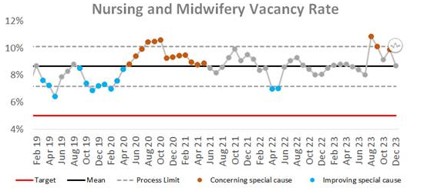
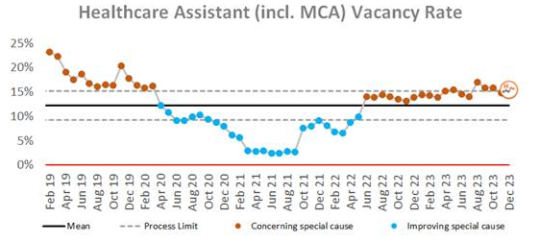
Combined Nursing and Midwifery Staffing Position Vacancy Rates
Graph 1. Nursing and midwifery vacancy rates
Vacancy position
The combined vacancy rate for Registered Nurses (RNs) and Registered Midwives (RMs) has decreased to 8.7 in December from 9.9% in November. The vacancy rate for Health care support workers (HCSWs) (including Maternity Care Assistants (MCAs) has increased to 15.7% in December (14.8% in November). When broken down further into Nursing and Midwifery specific vacancies, the MCA workforce vacancy rate has decreased to 16.1% from 19.3% in November. The HCSW vacancy rate (excl MCA) has increased to 15.7% from 14.8% in November.
The HCSW (including MCA’s) turnover rate remains high but is a decreasing trend (15.4% in December from 15.8% in November). The main reason for HCSWs leaving is voluntary resignation – relocation (29.9%) and the next highest reason is voluntary resignation – work life balance (25.1%). The leavers destination is unknown for the majority of HCSWs (46%), 15% of HCSW’s are leaving to take up employment in other NHS organisations and 10.7% are leaving for no employment.
Graph 2. Healthcare Assistant vacancy rates

Slide 4
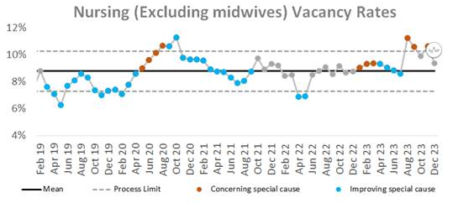
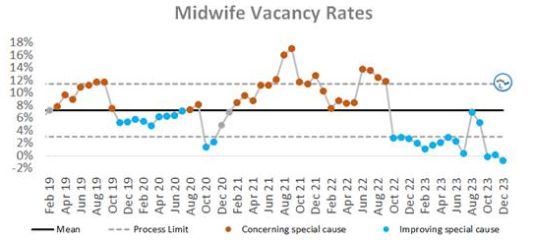
Staffing Position Vacancy Rates for Registered Nurses and Registered Midwives
Graph 3. Registered Nurse vacancy rates
Vacancy position
The vacancy rate for RNs working in adult areas has decreased to 9.4% in December (10.6% in November) as illustrated in Graph 3. The vacancy rate for registered children's nurses has also decreased slightly to 18.7% compared to 18.9% in November.
The vacancy rate for Registered Midwives has decreased to -0.76% for December compared to 0.14% in November as illustrated in Graph 4.
The turnover rate in December remains high but has slightly decreased to 10.3% for RNs in adult areas (10.4% in November), for RMs to 13.4% (13.5% in November). Conversely, there has been a small increase in Registered children's nurses to 14.3% in December from 14.2% in November. The main reasons for RMs leaving is voluntary resignation – relocation (35.1%) and the next highest reason is voluntary resignation – work life balance (21.6%). The main reason for RNs leaving is voluntary resignation – relocation (40.6%). The leavers destination data demonstrates that 27.3% of RNs and 35.1% of RMs are leaving to take up employment in other NHS organisations. 18.9% of RMs are leaving for no employment compared with 9.6% of RNs.
Graph 4. Registered Midwife vacancy rates

Slide 5
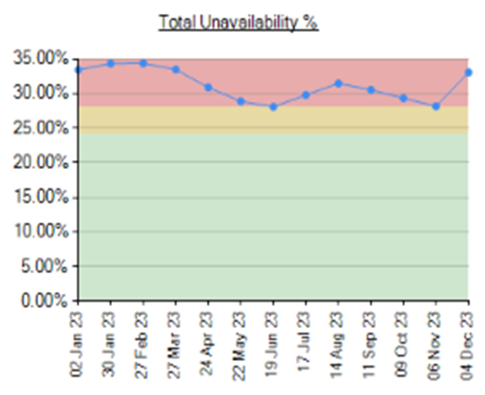
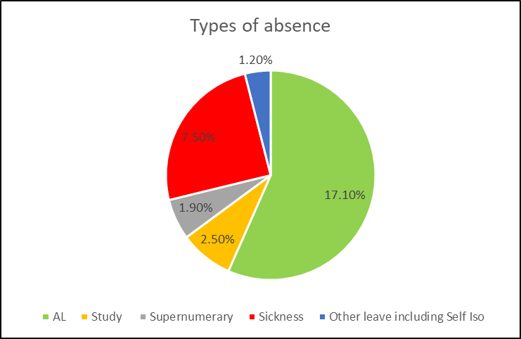
Unavailability for Registered Nurses, Midwives and Health Care Support Workers
Graph 5. Unavailability of staff
Unavailability of staff
Unavailability relates to periods of time where an employee has been given leave from their regular duties. This might be due to circumstances such as annual leave, sick leave, study leave, carers leave etc.
The total unavailability of the workforce working time in December 23 has increased by 4.8% to 30.2% as illustrated in Graph 5. This increase was also seen in December 22 and is associated with annual leave and closures of units over the Christmas and New Year Period. Compared to December 22 unavailability is 4.3% lower in December 23 due to a lower sickness recorded.
Graph 6 illustrates the percentage breakdown of the type of unavailability. The majority of unavailability (17.1%) was due to planned annual leave which would have been accounted for in the department rosters. There was a high percentage of unplanned leave that would have impacted upon fill rates within the rosters. In December, sickness absence has remained high and increased slightly to 7.5% (7.0% in November). Other leave has remained static at 1.2%, 2.5% was due to study leave and 1.90% was due to supernumerary time.
Graph 6. Types of absence

Slide 6
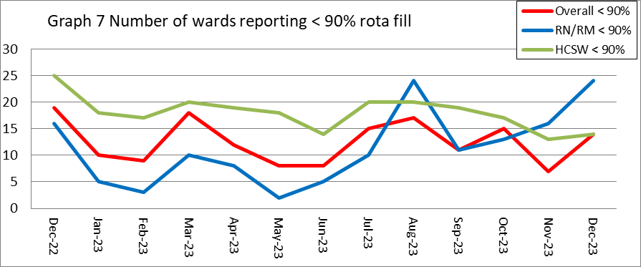
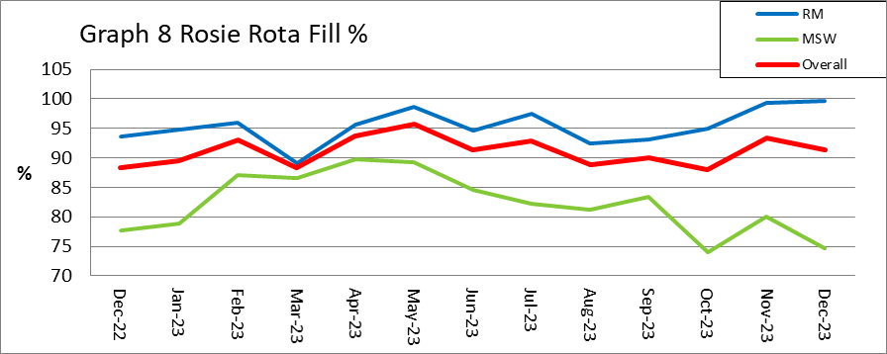
Planned versus actual staffing
Planned versus actual staffing
Graph 7 illustrates trend data for all wards reporting < 90% rota fill. The number of areas reporting <90% rota fill for registered RN/RM has increased to 24 in December from 16 in November. The number of areas reporting <90% rota fill for HCSWs in December has increased to 14 from 13 in November. The number of ward areas reporting overall fill rates of <90% in December has increased to 14 compared to 7 in December. Appendix 1. details the exception reports for all areas reporting RN/RM fill rates of <90%.
The number of occasions that 1 critical care nurse has needed to care for more than 1 level 3 patient has increased in December to 38 occasions compared to 4 in November. Additionally, there have been 79 occasions in December where there has been no side room coordinator (53 in November). Any concerns with regards to critical care staffing is escalated through the senior nurse of the day. Staffing has been supported through the use of temporary workers (agency and bank) and registered staff (non critical care trained) are redeployed from the operational pool and clinical areas on a shift-by-shift basis. There was also short term agreement to pay critical care trained staff bank enhancement to reduce the over all amount of GPICS breaches. Critical care have opened 3 of the beds that were closed due to staffing resulting in 55 open beds rather than 59 beds. Recruitment is ongoing to the vacant positions with a plan to open the remaining 4 beds when vacancy allows.
Midwifery & MSW fill rate
Graph 8 illustrates that the overall fill rate for maternity has decreased slightly to 91.4% in December form 93.3% in November which is higher than the 12-month average of 91.1%. The lowest fill rates have been seen on Lady Mary Ward (81%). Mitigated through redeployment of staff where required to meet acuity needs.

Slide 7
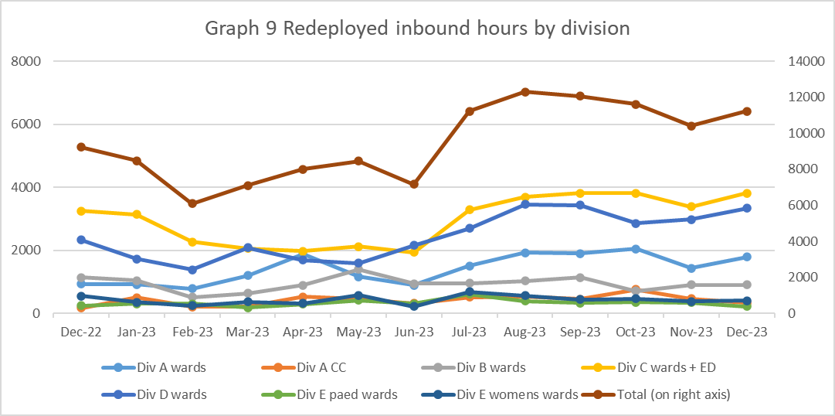
Staff deployment
Staff deployment
Graph 9 illustrates the movement of staff across wards to support safe staffing to ensure patient safety. This includes staff who are moved on an ad hoc basis (shift by shift) and shows which division they are deployed to.
The number of substantive staff redeployed has increased in December after a decreasing trend over the last 3 months with 362.5 working hours being redeployed per day in December (335.882 hours in November). This equates to 31.52 long day or night shifts per day. 141 of these hours were redeployments made outside of staff members own division to support patient safety (November 144 hours). Staffing is also being supported by the operational pool whereby bank staff book a bank shift on the understanding that they will work anywhere in the trust where support is required.
Nursing Pipeline
Appendix 2 provides detail on the forecasted position in relation to the number of adult RN vacancies based on FTE and includes UK experienced, UK newly qualified, apprenticeship route, EU and international up to March 2024. The current forecast demonstrates a year end band 5 RN vacancy position of 0.19% which exceeds the target of 5%. The Trust has reached the 5% target of band 5 Adult Nursing in December 2023. There has been an increase in establishment in January onwards with opening of U3. The RN adult pipeline for 2023/24 now reflects the reduction in international recruitment. This is a national concern and has been escalated to NHS England. Work is being undertaken to explore RN Recruitment initiatives including increasing the International Recruitment pay band and reviewing our shortlisting criteria.
Appendix 3 provides detail on the forecasted position in relation to the number of Paediatric band 5 RN and HCSW vacancies up to March 2024. Numbers are based on those interviewed and offered positions in addition to planned campaigns. The current forecast demonstrates a year end band 5 Paediatric RN vacancy position of 16.7% and a band 2 HCSW position of 7.22%.
Whilst the recruitment pipeline is positive with multiple pipelines including apprenticeship routes, domestic and international recruitment, the predicted numbers are only achievable if the appropriate infrastructure is in place to support.

Slide 8
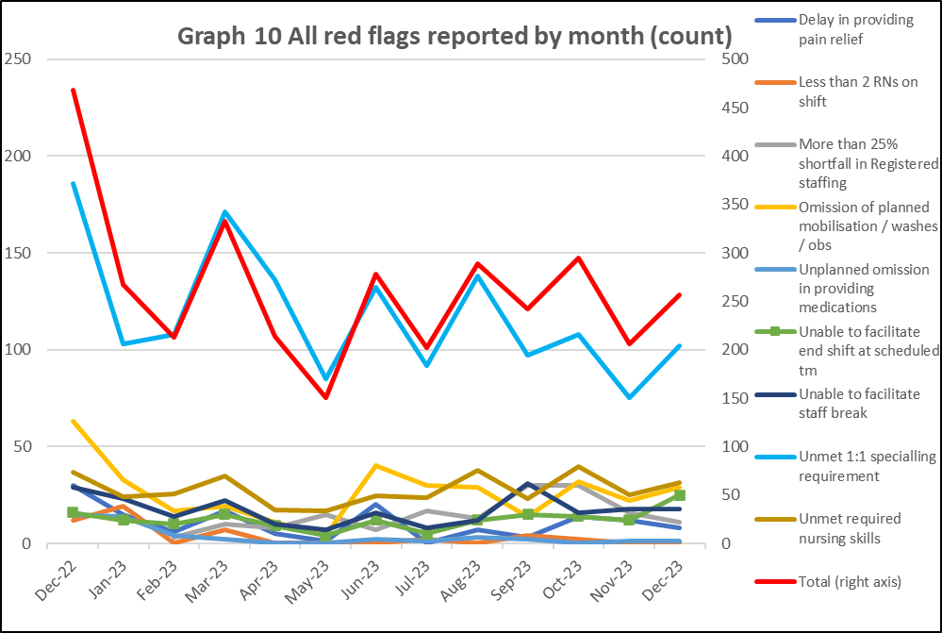
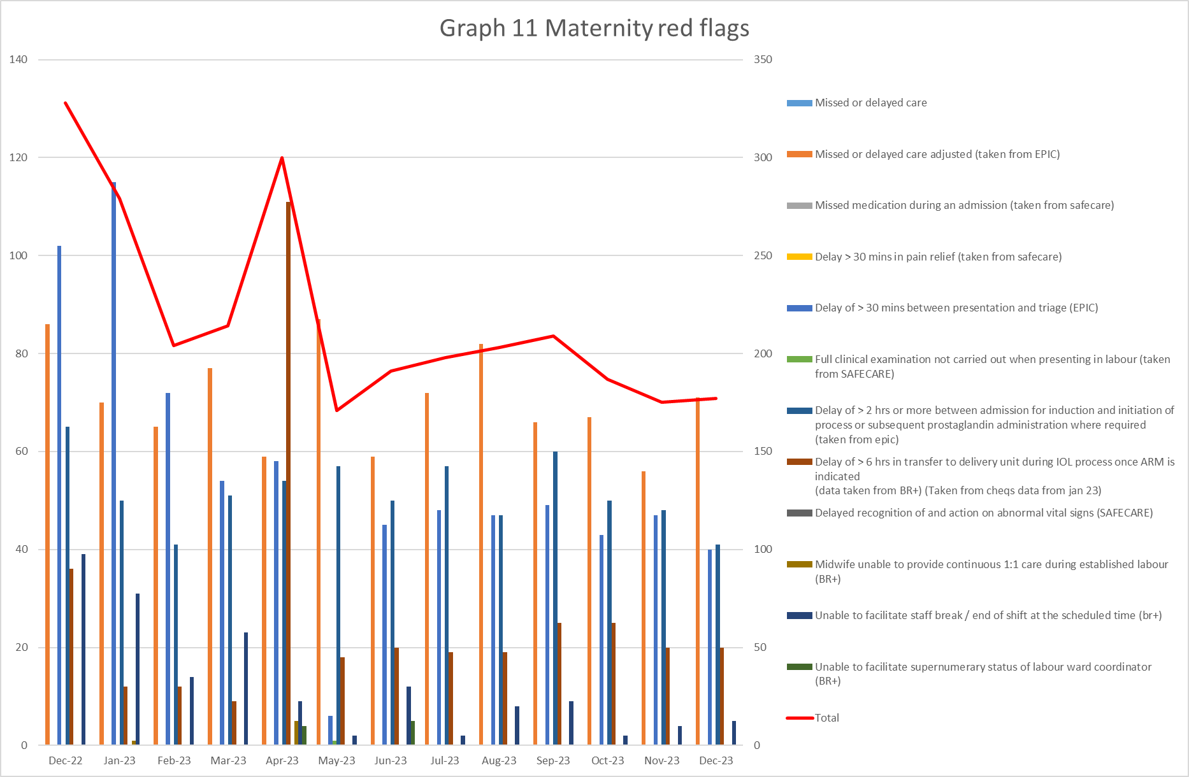
Red flags
Red Flags
A staffing red flag event is a warning sign that something may be wrong with nursing or midwifery staffing. If a staffing red flag event occurs, the registered nurse or midwife in charge of the service should be notified and necessary action taken to resolve the situation.
Nursing red flags
Graph 10 illustrates that there has been an increase in the number of red flags reported with 257 reported in December. The highest number of red flags reported in December was in relation to an unmet 1:1 specialling requirement (102 compared with 75 in November). A trust wide improvement project focusing on specialling is being developed to review specialling across the organisation. There has been an increase in 1 reportable red flags in December with the remaining all reducing or staying static. The increase was seen in omission in planned mobilisation and washes 29 (22 in November).
Maternity red flags
The number of maternity red flags has increased slightly from 175 in November to 177 in December. Graph 11 illustrates the red flags that have been reported with the highest reported being for missed or delayed care 40.1%. All other red flags have seen a reduction with the exception of unable to facilitate staff break 2.8% in December (2.3% in November). Delay of >30mins has seen a reduction 4.3% in December. This is a known area of concern as highlighted in the recent CQC report and work is in progress to address this. High numbers of unresolved red flags that cannot be mitigated will trigger escalation to divert policy with actions including:- redeployment of staff to higher acuity areas, seeking support from system for elective work such as caesarean sections and inductions of labour.

Slide 9
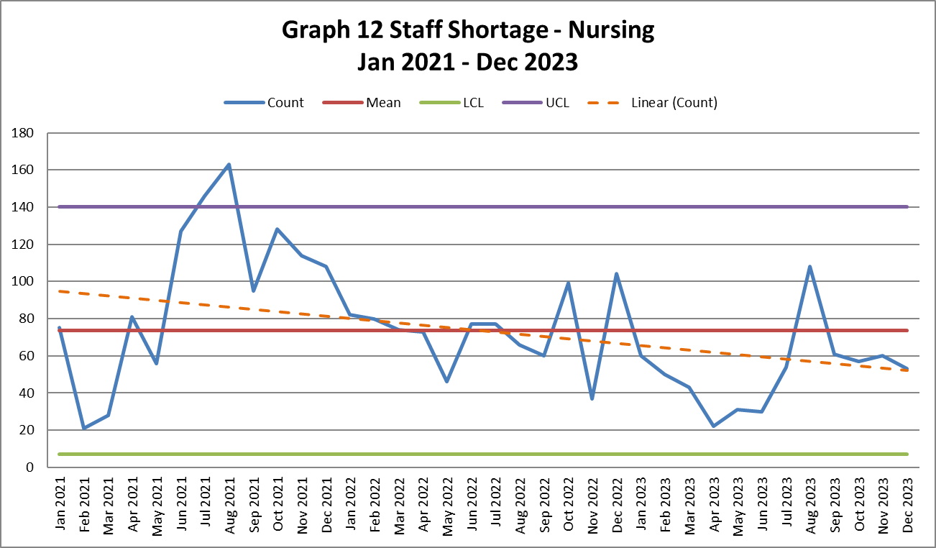
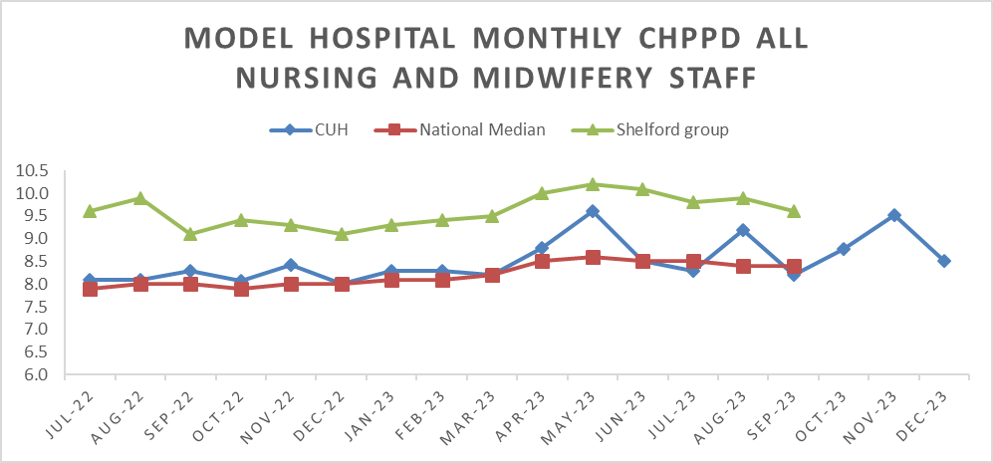
Safety and Risk
Incidents reported relating to staff shortages
Graph 12 illustrates the trend in Safety Learning Reports (SLRs) completed in relation to nurse staffing. In December there were 53 incidents reported compared to 60 in November.
The majority of the incidents related to staffing levels in December were reported by division E (75) with the highest reporting area being Rosie Birth Centre (10).
Care hours per patient day (CHPPD)
Care hours per patient day (CHPPD) is the total number of hours worked on the roster (clinical staff including AHPs) divided by the bed state captured at 23.59 each day. NHS Improvement began collecting care hours per patient day formally in May 2016 as part of the Carter Programme. All Trusts are required to report this figure externally.
CUH CHPPD recorded for December has decreased to 8.5 from 9.52 in November however this remains below other Shelford hospitals (10.3).
In maternity, from 1 April 2021, the total number of patients now includes babies in addition to transitional care areas and mothers who are registered as a patient. CHPPD for the delivery unit in December has increased to 16.9 (15.02 in November).
Graph 13: Care Hours Per Patient Day (CHPPD)

Slide 10
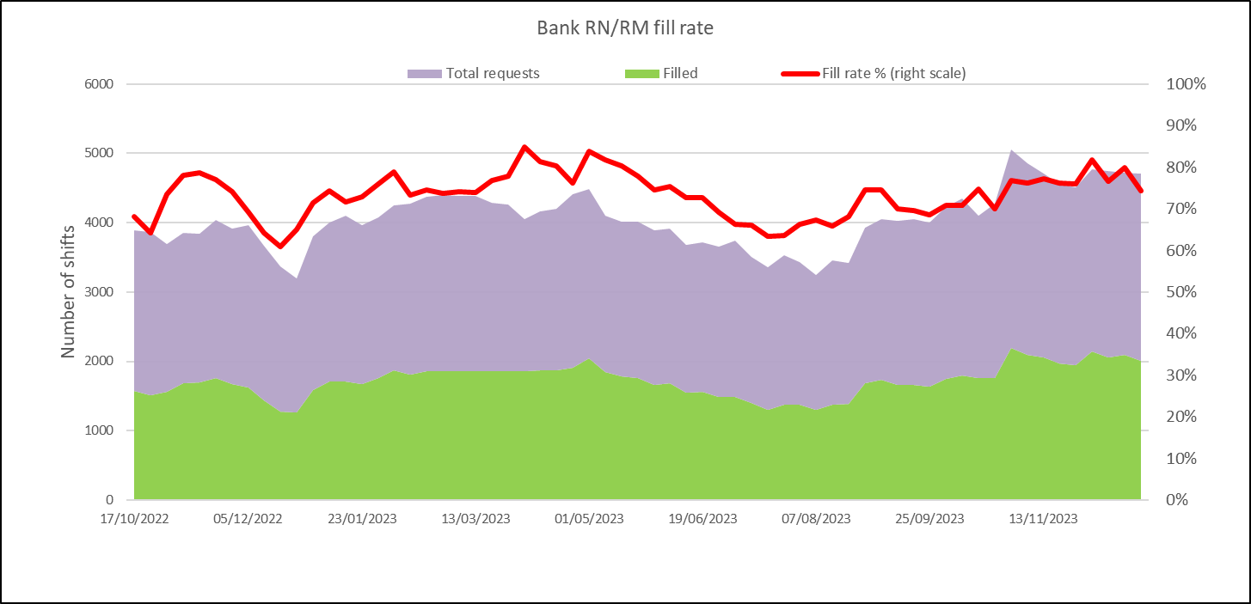
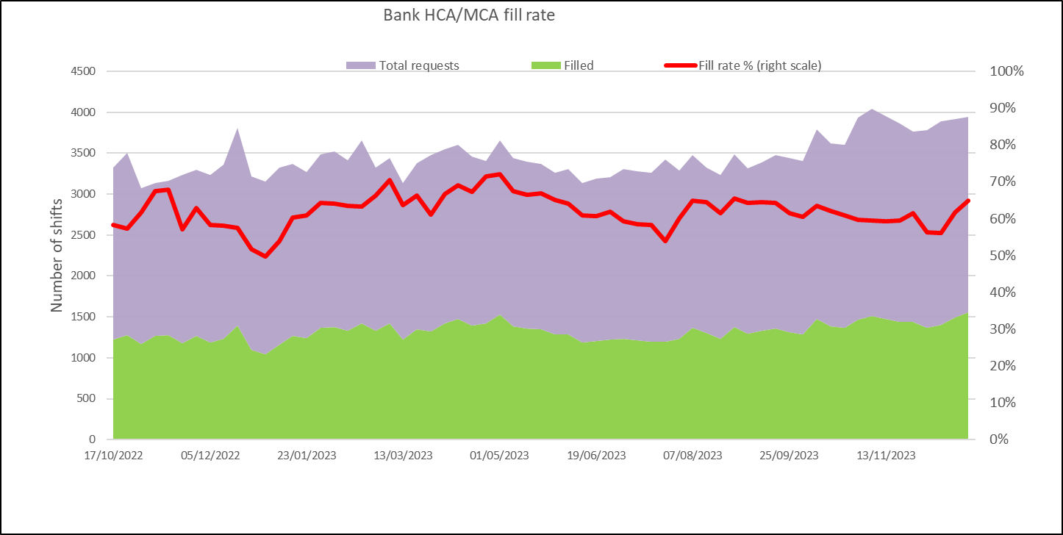
Bank Fill Rate and Agency Usage
Graph 14 Registered RN/RM Bank fill rate per week
Bank fill rate
The Trust’s Staff Bank continues to support the clinical areas with achieving safe staffing levels. Graph 14 and 15 illustrate the trends in bank shift fill rate per week. Overall, we continued to see an increase in December for bank shift requests for registered staff to mitigate those areas who have less than a rota fill of 90% or to cover an unmet specialling need. The number of requests for registered staff is an average of 2656 shifts per week with an average bank fill rate of 78% which is an increase from 76% in November.
The number of requests for Health care support workers and Maternity support workers remains high with an average of 2410 shifts per week with an average bank fill rate of 60.14% this is a slight increase from 59.9% in November.
In addition to bank workers, we have the equivalent of 15.95 WTE agency workers working (13.09 WTE in November) across the divisions to support staffing challenges in the short term. This agency usage had been reducing but to support the emergency department and critical care there has been a need to increase to support safe staffing.
Short term pay enhancements for bank shifts have been put in place to support staff being deployed. Any bank enhancements in place are reviewed regularly (at least on a 6 weekly basis) through the weekly bank enhancement meeting and are for fixed periods of time.
Graph 15 HCSW/MSW bank fill rate per week

Slide 11
Appendix 1: Exception report by Division

Slide 17
Appendix 2: Adult RN Recruitment pipeline

Slide 18
Appendix 3: Paediatric RN and Band 2 HCSW Recruitment pipeline

