Slide 1
Monthly Nurse Safe Staffing
Sponsoring executive director: Lorraine Szeremeta, Chief Nurse
Amanda Small, Deputy Chief Nurse
Christopher Gray, Lead Nurse Safer Staffing
Sarah Raper, Project Lead Nurse safe staffing
Board of Directors: 13 December 2023

Slide 2
Executive Summary
This slide set provides an overview of the Nursing and Midwifery staffing position for October 2023.
The vacancy position in October has decreased in all areas with the exception of maternity care assistants (MCA). For registered children's nurses (RSCNs) the vacancy rate is 20.1% (21.1% in September), Health Care Support Workers (HCSW) 15.4% (15.6% in September), Registered Nurses (RNs) 9.9% (10.6% in September) and Registered Midwifes (RMs) - 0.1% (5.31% in September). The MCA vacancy rate has increased to 25.5% from 21.8% in September. The turnover rate in October remains high but has decreased for RMs (12.15% from 12.9% in September) and HCSW (including MCA’s) 16.3% (17.1% in September). However, for RNs turnover has increased slightly to 10.8% (10.6% in September) and RCSN has increased to 15.7% (15.4% in September). The main reason for leaving for RN’s, RM’s, RSCN’s and HCSW’s is voluntary resignation – relocation. The leavers destination data demonstrates that 27.5% of RNs and 42.4% of RMs are leaving to take up employment in other NHS organisations. 18.2% of RMs are leaving for no employment compared to 8.9% of RNs. Conversely, the leavers destination is unknown for the majority of HCSWs (47%).
The planned versus actual staffing report demonstrates that 15 clinical areas reported <90% overall rota fill in October (11 in September). The overall fill rate for maternity has decreased to 88% compared to 90.8% in September. The total unavailability of the workforce working time in October has decreased by 0.9% to 26.6%. The majority of unavailability (12.4%) is due to planned annual leave, sickness absence has remained relatively static in October at 7.7% (7.6% in September). Additionally, 1.2% of working time was unavailable due to other leave, 3.6% was due to study leave and 1.7% was due to supernumerary time.
In order to mitigate staffing risks, the number of requests for bank workers remains high with an average of 2740 shifts per week requested for registered staff and 2029 shifts requested for Health care support workers and Maternity support workers per week with an average bank fill rate of 71.61% for registered staff and 61.71% for Health Care Support workers. In addition, the equivalent of 12.9 WTE agency workers are working across the divisions (14.62 WTE in September). Despite this, redeployment of nurses and midwives has remained necessary due to staff unavailability, with an average of 374.62 working hours being redeployed each day of which there is a continued need to redeploy staff out of their division 200 hours in total (760 hours in September).
The number of occasions that 1 critical care nurse has needed to care for more than 1 level 3 patient has decreased in October to 7 occasions compared to 79 in September. Additionally, there have been 74 occasions in October where there has been no side room co-ordinator (155 in September). Any concerns with regards to critical care staffing are escalated through the senior nurse of the day. Staffing has been supported through the use of temporary workers (agency and bank), enhanced bank rates and registered staff (non critical care trained) are redeployed from the operational pool and clinical areas on a shift by shift basis. Critical care have opened 3 of the beds that were closed due to staffing resulting in 55 open beds rather than 59 beds. Recruitment is ongoing to the vacant positions with a plan to open the remaining 4 beds when vacancy allows.

Slide 3
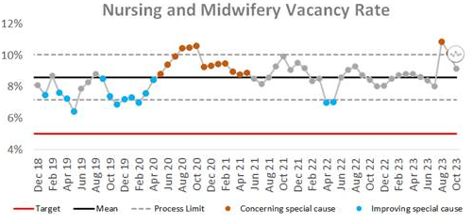
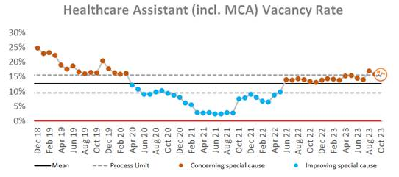
Combined Nursing and Midwifery Staffing Position Vacancy Rates
Graph 1. Nursing and midwifery vacancy rates
Vacancy position
The combined vacancy rate for Registered Nurses (RNs) and Registered Midwives (RMs) has decreased further to 9.1% in October from 10.1% in September. The vacancy rate for Health care support workers (HCSWs) (including Maternity Care Assistants (MCAs) is static at 15.9% in October (15.9% in September). When broken down further into Nursing and Midwifery specific vacancies, the MCA workforce vacancy rate has increased for October to 25.5% from 21.8% in September. The HCSW vacancy rate (excl MCA) has decreased in October to 15.4% from 15.6% in September.
The HCSW (including MCAs) turnover rate remains high and has decreased slightly to 16.3% in October from 17.1% in September. The main reason for HCSWs leaving is voluntary resignation – relocation (31.8%) and the next highest reason is voluntary resignation – work life balance (26.3%). The leavers destination is unknown for the majority of HCSWs (47%), 15.2% of HCSW’s are leaving to take up employment in other NHS organisations and 10.6% are leaving for no employment.
Graph 2. Healthcare Assistant vacancy rates

Slide 4
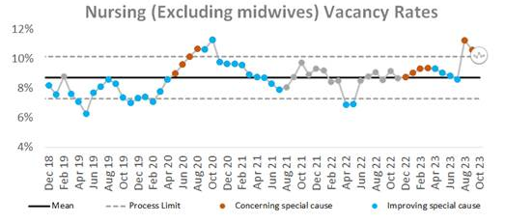
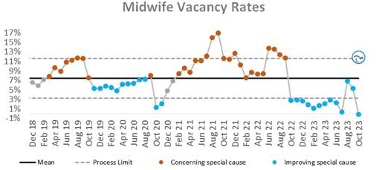
Staffing Position Vacancy Rates for Registered Nurses and Registered Midwives
Graph 3. Registered Nurse vacancy rates
Vacancy position
The vacancy rate for Registered Nurses working in adult areas has decreased to 9.9% in October (10.6% in September) as illustrated in Graph 3. The vacancy rate for registered children's nurses has also decreased to 20.1% compared to 21.1% in September.
The vacancy rate for Registered Midwives has reduced to -0.1% for October compared to 5.31% in September as illustrated in Graph 4. It should be noted that this reduction in vacancy rate is due to the large number of newly qualified midwives commencing employment and as such there will be a period of time required to consolidate their learning in practice.
The turnover rate in October remains high and has increased to 10.8% for RNs in adult areas (10.6% in September) and to 15.7% for Registered children's nurses (15.4% in September). Conversely, turnover has reduced for RMs to 12.15% (12.9% in September). The main reasons for RMs leaving is voluntary resignation – relocation (30.3%) and the next highest reason is voluntary resignation – work life balance (24.2%). The main reason for RN’s leaving is voluntary resignation – relocation (42.4%). The leavers destination data demonstrates that 27.5% of RNs and 42.4% of RMs are leaving to take up employment in other NHS organisations. 18.2% of RMs are leaving for no employment compared with 8.9% of RNs.
Graph 4. Registered Midwife vacancy rates

Slide 5
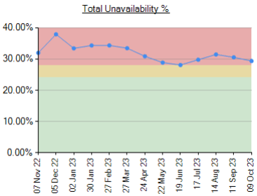
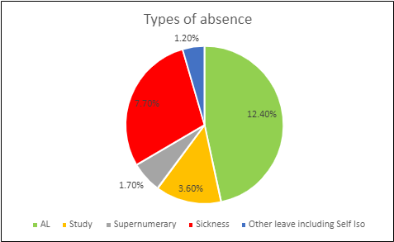
Unavailability for Registered Nurses, Midwives and Health Care Support Workers
Graph 5. Unavailability of staff
Unavailability of staff
Unavailability relates to periods of time where an employee has been given leave from their regular duties. This might be due to circumstances such as annual leave, sick leave, study leave, carers leave etc.
The total unavailability of the workforce working time in October 23 has decreased by 0.9% to 26.6% as illustrated in Graph 5.
Graph 6 illustrates the percentage breakdown of the type of unavailability. The majority of unavailability (12.4%) was due to planned annual leave which would have been accounted for in the department rosters. There was a high percentage of unplanned leave that would have impacted upon fill rates within the rosters. In October, sickness absence has remained relatively static at 7.70% (7.60% in September). Other leave has remained static at 1.2%, 3.6% was due to study leave and 1.70% was due to supernumerary time.
Graph 6. Types of absence

Slide 6
Planned versus actual staffing
Planned versus actual staffing
Graph 7 illustrates trend data for all wards reporting < 90% rota fill. The number of areas reporting <90% rota fill for registered RN/RM has increased to 13 in October from 11 in September. The number of areas reporting <90% rota fill for HCSWs in October has decreased slightly to 17 from 19 in September. The number of ward areas reporting overall fill rates of <90% in October has increased to 15 compared to 11 in September. Appendix 1. details the exception reports for all areas reporting RN/RM fill rates of <90%.
The number of occasions that 1 critical care nurse has needed to care for more than 1 level 3 patient has decreased in October to 7 occasions compared to 79 in September. Additionally, there have been 74 occasions in October where there has been no side room coordinator (155 in September). Any concerns with regards to critical care staffing are escalated through the senior nurse of the day. Staffing has been supported through the use of temporary workers (agency and bank) and registered staff (non critical care trained) are redeployed from the operational pool and clinical areas on a shift-by-shift basis. There was also short term agreement to pay critical care trained staff bank enhancement to reduce the over all amount of GPICS breaches. Critical care have opened 3 of the beds that were closed due to staffing resulting in 55 open beds rather than 59 beds. Recruitment is ongoing to the vacant positions with a plan to open the remaining 4 beds when vacancy allows.
Midwifery & MSW fill rate
Graph 8 illustrates that the overall fill rate for maternity has decreased slightly to 88% in October form 90% in September which is lower than the 12-month average of 90.9%. The lowest fill rates have been seen on Rosie Birth Centre (79%).

Slide 7
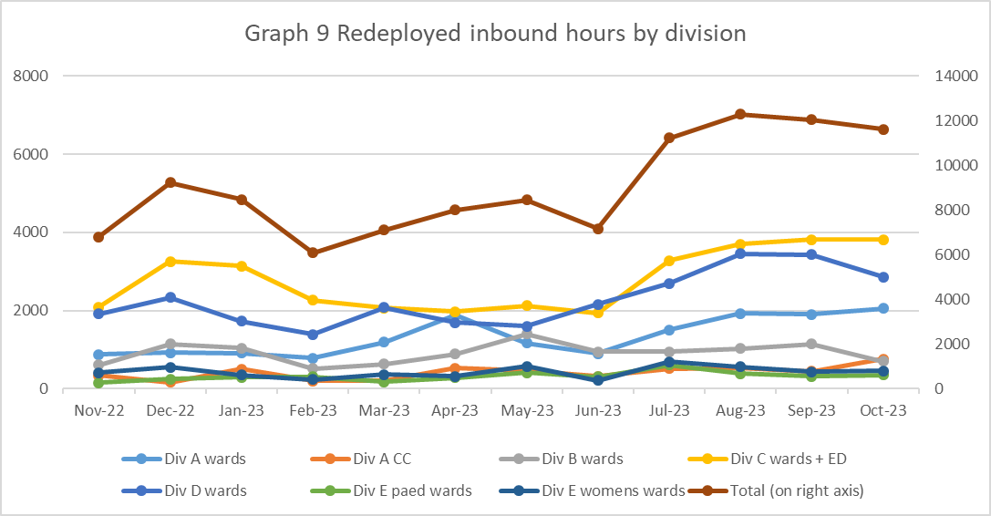
Staff deployment
Staff deployment
Graph 9 illustrates the movement of staff across wards to support safe staffing to ensure patient safety. This includes staff who are moved on an ad hoc basis (shift by shift) and shows which division they are deployed to.
The number of substantive staff redeployed has slightly reduced after the increasing trend over 3 months of July to September with 374.62 working hours being redeployed per day in October (388.95 hours in September). This equates to 32.5 long day or night shifts per day. 200 of these hours were redeployments made outside of staff members own division to support patient safety (September 760 hours). Staffing is also being supported by the operational pool whereby bank staff book a bank shift on the understanding that they will work anywhere in the trust where support is required.
Nursing Pipeline
Appendix 2 provides detail on the forecasted position in relation to the number of adult RN vacancies based on FTE and includes UK experienced, UK newly qualified, apprenticeship route, EU and international up to March 2024. The current forecast demonstrates a year end band 5 RN vacancy position of 5.01% which is slightly above the target of 5%. The RN adult pipeline for 2023/24 now reflects the reduction in international recruitment. This is a national concern and has been escalated to NHS England. Work is being undertaken to explore RN Recruitment initiatives including increasing the International Recruitment pay band and reducing our shortlisting criteria.
Appendix 3 provides detail on the forecasted position in relation to the number of Paediatric band 5 RN and HCSW vacancies up to March 2024. Numbers are based on those interviewed and offered positions in addition to planned campaigns. The current forecast demonstrates a year end band 5 Paediatric RN vacancy position of 19.84% and a band 2 HCSW position of 8.15%.
Whilst the recruitment pipeline is positive with multiple pipelines including apprenticeship routes, domestic and international recruitment, the predicted numbers are only achievable if the appropriate infrastructure is in place to support.

Slide 8
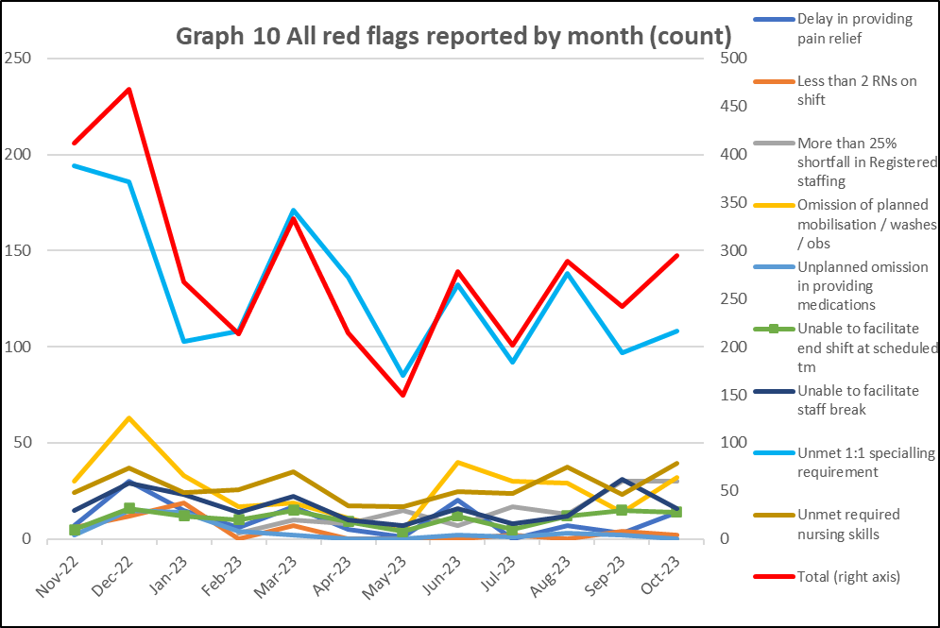
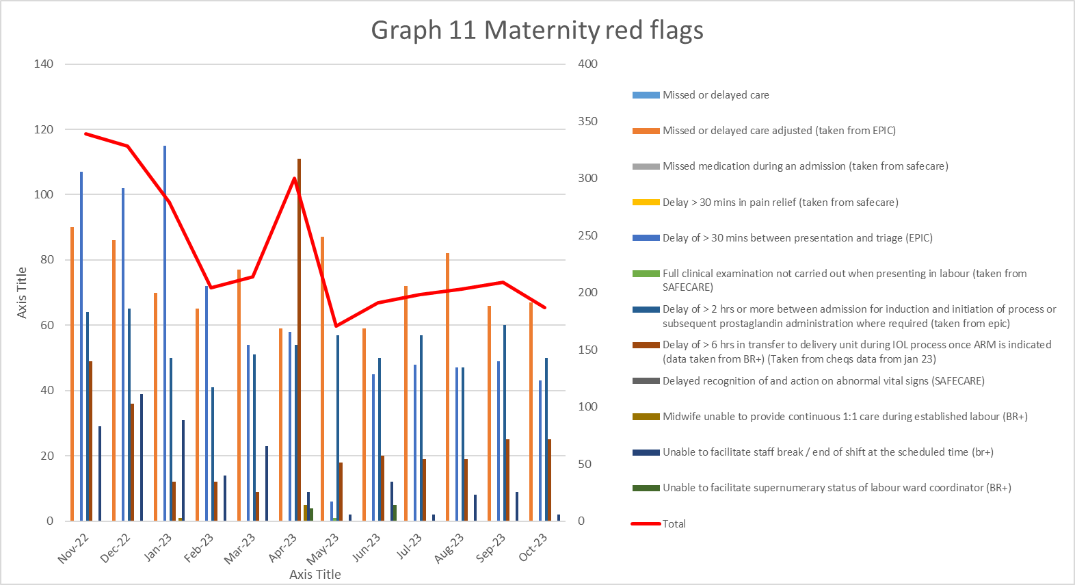
Red flags
Red Flags
A staffing red flag event is a warning sign that something may be wrong with nursing or midwifery staffing. If a staffing red flag event occurs, the registered nurse or midwife in charge of the service should be notified and necessary action taken to resolve the situation.
Nursing red flags
Graph 10 illustrates that there has been a increase in the number of red flags reported with 295 reported in October. The highest number of red flags reported in October was in relation to an unmet 1:1 specialling requirement (108 compared with 97 in September). A trust wide improvement project focusing on specialling is being developed to review specialling across the organisation. There has been an increase in 3 reportable red flags in October with the remaining reducing or staying equal. The increases were seen in: Omission of planned mobilisation/washes/obs 32 (14 in September), Delay in pain relief 14 (3 in September) and unmet required nursing skills 79 (46 in September) In, October 2 red flags were reported for less than 2 RN on shift. On further investigation these were raised in error but not resolved.
Maternity red flags
The number of maternity red flags have seen a decrease from 209 in September to 187 in October. Graph 11 illustrates the red flags that have been reported. The highest number of red flags reported is for missed or delayed care 35.8%. All others have seen a reduction. 23.0% of red flags reported were due to a delay of >30mins between presentation and triage. This is a known area of concern as highlighted in the recent CQC report.

Slide 9
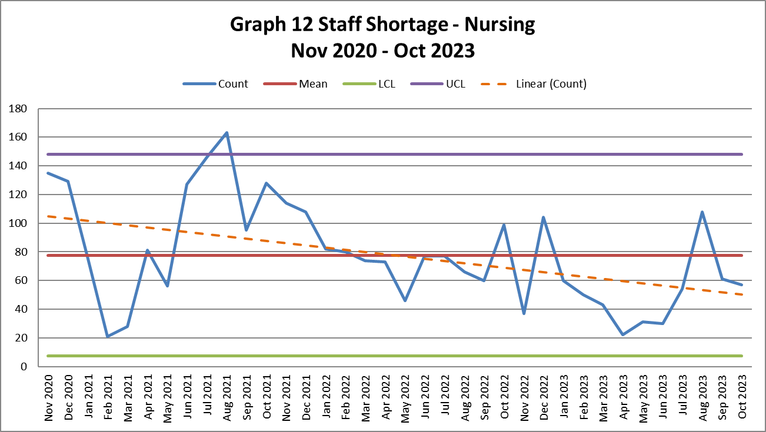
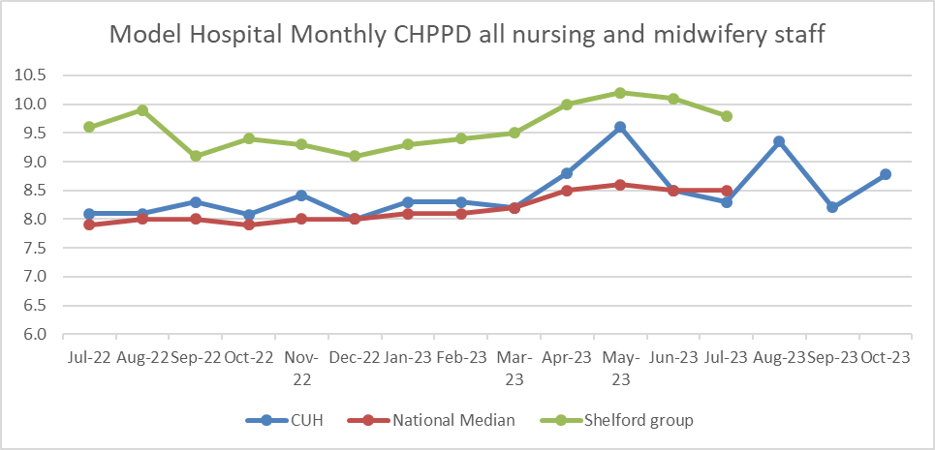
Safety and Risk
Incidents reported relating to staff shortages
Graph 12 illustrates the trend in Safety Learning Reports (SLRs) completed in relation to nurse staffing. In October there were 57 incidents reported compared to 61 in September.
The majority of the incidents related to staffing levels in September were reported by division D (16) with the highest reporting area being A4 (5). The highest reporting area for the organisation was NICU with 7. Safety continues to be monitored through the site safety meetings.
Care hours per patient day (CHPPD)
Care hours per patient day (CHPPD) is the total number of hours worked on the roster (clinical staff including AHPs) divided by the bed state captured at 23.59 each day. NHS Improvement began collecting care hours per patient day formally in May 2016 as part of the Carter Programme. All Trusts are required to report this figure externally.
CUH CHPPD recorded for increased to 8.78 from 8.35 in September. This is below other Shelford hospitals (10.3).
In maternity, from 1 April 2021, the total number of patients now includes babies in addition to transitional care areas and mothers who are registered as a patient. CHPPD for the delivery unit in September has increased to 16.78 for October (14.34 in September).
Graph 13: Care Hours Per Patient Day (CHPPD)

Slide 10
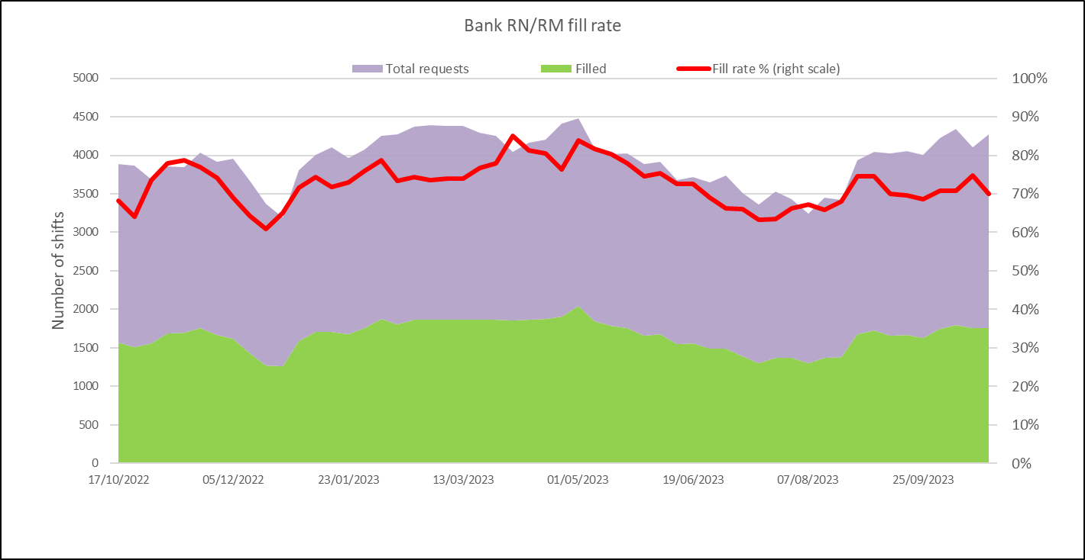
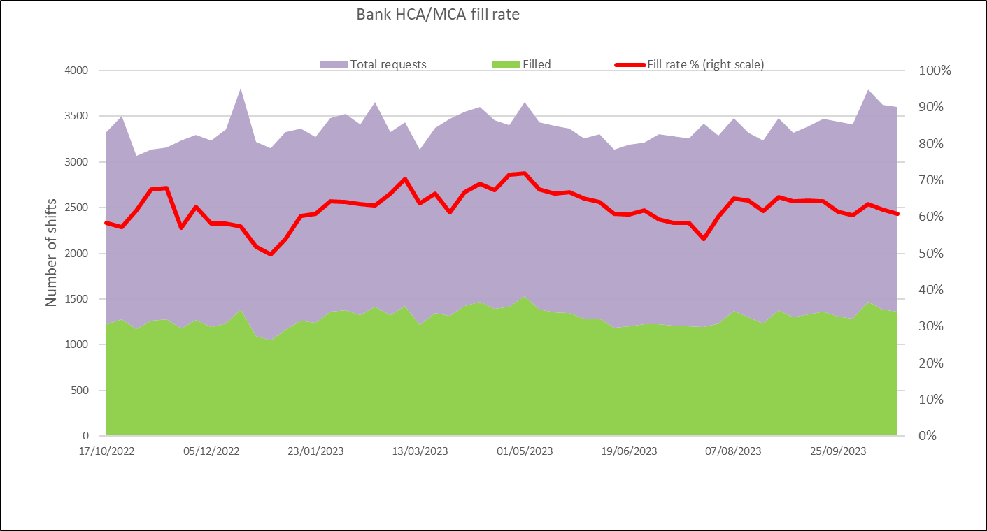
Bank Fill Rate and Agency Usage
Graph 14 Registered RN/RM Bank fill rate per week
Bank fill rate
The Trust’s Staff Bank continues to support the clinical areas with achieving safe staffing levels. Graph 15 and 16 illustrate the trends in bank shift fill rate per week. Overall, we continued to see a increase in October for bank shift requests for registered staff to mitigate those areas who have less than a rota fill of 90% or to cover an unmet specialling need. The number of requests for registered staff is an average of 2740 shifts per week with an average bank fill rate of 71.61% which is an increase from 70.71% in September.
The number of requests for Health care support workers and Maternity support workers remains high with an average of 2029 shifts per week with an average bank fill rate of 61.71% this is a slight decrease from 63.63% in September.
In addition to bank workers we have the equivalent of 12.9 WTE agency workers working (14.6 WTE in September) across the divisions to support staffing challenges in the short term. This agency usage had been reducing but to support the emergency department and critical care there has been a need to increase to support safe staffing.
Short term pay enhancements for bank shifts put in place earlier in the year to encourage a higher uptake of shifts had been reduced in July with these now only being targeted to those areas with the highest vacancy. There has been a slight reduction in bank fill in correlation with this but not a significant decrease. This trend will continue to be monitored. Any bank enhancements in place are reviewed regularly (at least on a 6 weekly basis) through the weekly bank enhancement meeting and are for fixed periods of time.
Graph 15 HCSW/MSW bank fill rate per week

Slide 11
Appendix 1: Exception report by Division

Slide 14
Appendix 2: Adult RN Recruitment pipeline
Adult band 5 RN position based on predictions and established FTE
Month | UK based exp. applicants | Anglia Ruskin NQ (60% of graduates) | Other NQ | Nursing Associates | NAP | Return to Practice | Overseas | Total New Starters | Leavers FTE | Promotions and transfer out of scope- retained by the trust | Staff in post FTE | ESR Establishment FTE | Vacancy rate based on established FTE | No. of vacancies based on established FTE | Starter leaver variance
Apr-23 | 5 | 2 |  |  | 12 |  | 9 | 28 | 9 | 11 | 1534 | 1699 | 9.70% | 165 | 19
May-23 | 1 | 3 |  |  | 5 |  | 12 | 21 | 14 | 12 | 1529 | 1699 | 10.01% | 170 | 7
Jun-23 | 4 |  |  |  | 2 |  | 16 | 22 | 7 | 13 | 1531 | 1699 | 9.89% | 168 | 15
Jul-23 | 1 | 1 | 2 |  |  |  | 19 | 23 | 16 | 10 | 1528 | 1699 | 10.06% | 171 | 7
Aug-23 | 3 | 1 |  |  |  |  | 16 | 20 | 11 | 10 | 1753 | 1931 | 9.20% | 177.64 | 9
Sep-23 | 7 | 3 | 2 |  |  |  | 35 | 47 | 16 | 7 | 1777 | 1951 | 8.90% | 173.64 | 31
Oct-23 | 1 | 11 | 2 |  |  |  | 40 | 54 | 14 | 12 | 1635 | 1759 | 7.05% | 124.01 | 40
Nov-23 | 6 | 4 |  |  |  |  | 28 | 38 | 15 | 14 | 1644 | 1828 | 10.06% | 183.91 | 23
Dec-23 | 6 | 4 |  |  | 16 |  | 49 | 75 | 13 | 15 | 1691 | 1828 | 7.49% | 136.91 | 62
Jan-24 | 7 | 3 |  |  |  | 2 | 40 | 52 | 13 | 15 | 1715 | 1828 | 6.18% | 112.91 | 39
Feb-24 | 3 |  |  | 2 |  |  | 35 | 40 | 13 | 15 | 1727 | 1867 | 7.48% | 139.61 | 27
Mar-24 | 5 | 27 | 7 |  |  |  | 35 | 74 | 13 | 15 | 1773 | 1867 | 5.01% | 93.61 | 61
TOTAL | 49 | 59 | 13 | 2 | 35 | 2 | 334 | 569 | 154 | 149 | 1773 | 1867 | 5.01% | 93.61 | 340

Slide 15
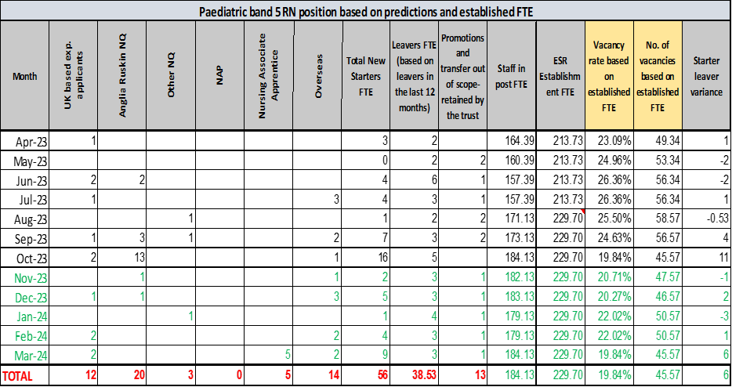
Appendix 3: Paediatric RN and Band 2 HCSW Recruitment pipeline

