Slide 1
Monthly Nurse Safe Staffing
Sponsoring executive director: Lorraine Szeremeta Chief Nurse
Amanda Small Deputy Chief Nurse
Sarah Raper Project Lead Nurse safe staffing
Board of Directors: 14 June 2023

Slide 2
Executive Summary
This slide set provides an overview of the Nursing and Midwifery staffing position for April 2023.
The vacancy position in April has remained relatively static for registered nurses (RNs) at 9.3%, registered children's nurses (RSCNs) at 20.4% from 20.2% in March and Registered Midwifes (RMs) at 2.12% from 1.74% in March. Conversely, the vacancy position has increased for Health Care Support Workers (HCSWs) to 14.9% from 13.7% in March and maternity care assistants (MCAs) to 21.9% from 18.8% in March. Turnover rate remains high at 12.5% for RNs, 12.0% for RMs, 15.4% for RSCNs and 18.4% for HCSWs. The main reason for leaving for RNs, RMs and RSCNs is voluntary resignation – relocation whereas for HCSWs it is voluntary resignation – work life balance.
The planned versus actual staffing report demonstrates that 12 clinical areas reported <90% overall rota fill in April (18 in March). The overall fill rate for maternity has increased in April to 93.7% compared to 88.3% in March. The total unavailability of the workforce working time in April has remained static at 30.3%. The majority of unavailability (18%) is due to planned annual leave, sickness absence has reduced slightly to 6.9% from 7.8% in March. Additionally, 1.3% of working time was unavailable due to other leave, 2.4% was due to study leave and 1.7% was due to supernumerary time.
In order to mitigate staffing risks, the number of requests for bank workers remains high with an average of 2327 shifts per week requested for registered staff and 2076 shifts requested for Health care support workers and Maternity support workers per week with an average bank fill rate of 80.6% for registered staff and 68.6% for Health Care Support workers. In addition, the equivalent of 37.4 WTE agency workers are working across the divisions. Despite this, redeployment of nurses and midwives has remained necessary due to staff unavailability, with an average of 258 working hours being redeployed each day of which all of the redeployed hours have been within the staff members own division.
The number of occasions that 1 critical care nurse has needed to care for more than 1 level 3 patient has decreased in April to 20 occasions compared with 54 in March. Additionally there have been 89 occasions in April where there has been no side room co-ordinator (174 in March). Any concerns with regards to critical care staffing are escalated through the senior nurse of the day. Staffing has been supported through the use of temporary workers (agency and bank), bank enhancements and registered staff (non critical care trained) are redeployed from the operational pool and clinical areas on a shift by shift basis. Critical care have opened 3 of the beds that were closed due to staffing resulting in 55 open beds rather than 59 beds. Recruitment is ongoing to the vacant positions with a plan to open the remaining 5 beds by September 2023.

Slide 3
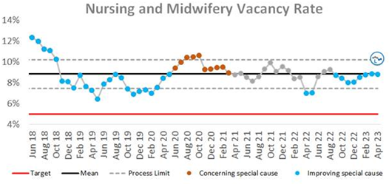
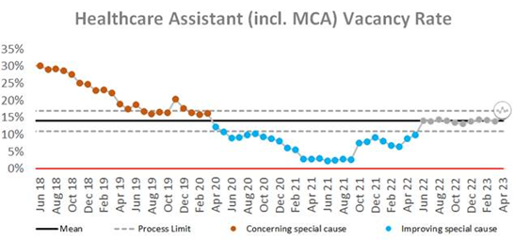
Combined Nursing and Midwifery Staffing Position Vacancy Rates
Graph 1. Nursing and midwifery vacancy rates
Vacancy position
The combined vacancy rate for Registered Nurses (RNs) and Registered Midwives (RMs) has remained static over the last 3 months at 8.8%. The vacancy rate for Health care support workers (HCSWs) (including Maternity Care Assistants (MCAs) has increased slightly to 15.2% from 14.3% in March. When broken down further into Nursing and Midwifery specific vacancies, the MCA workforce vacancy rate has increased from 18.8% in March to 21.9% in April. The HCSW vacancy rate (excl MCA) has also increased to 14.9% from 13.7% in March.
The HCSW (including MCAs) turnover rate remains high at 18.4%. The main reason for HCSWs leaving is voluntary resignation – work life balance (27.6%) and the next highest reason is voluntary resignation – relocation (27.1%). The leavers destination is unknown for the majority of HCSWs (47.9%), 14.5% of HCSW’s are leaving to take up employment in other NHS organisations and 12.7% are leaving for no employment.
Graph 2. Healthcare Assistant vacancy rates

Slide 4
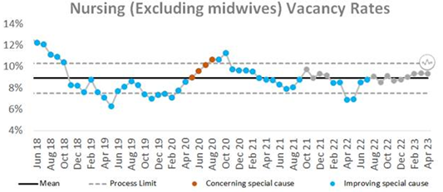
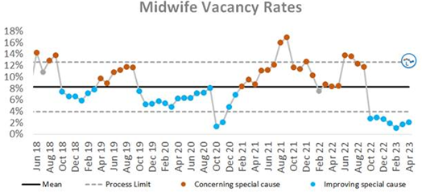
Staffing Position Vacancy Rates for Registered Nurses and Registered Midwives
Graph 3. Registered Nurse vacancy rates
Vacancy position
The vacancy rate for Registered Nurses working in adult areas remains static at 9.3% as illustrated in Graph 3. The vacancy rate for registered children's nurses also remains relatively static at 20.4% compared to 20.2% in March.
The vacancy rate for Registered Midwives illustrates a sharp increase in Graph 4 in June 22 however this was due to the work that had been undertaken to align the workforce Electronic Staff Record (ESR) and financial ledger to reflect the additional approved investment in the maternity workforce. Over the last 6 months, there has been a decreasing trend in the vacancy rate from 13.0% in July to 1.74% in March however there has been a slight increase in April to 2.12%.
The turnover rate in April remains high at 12.5% for RNs in adult areas (12.9% in March), 15.4% for Registered children's nurses (15.0% in March) and 12.0% for RMs (11.7% in March). The main reasons for RMs leaving is voluntary resignation – relocation (25.8%) and the next highest reason is voluntary resignation – work life balance (22.6%). The main reason for RN’s leaving is voluntary resignation – relocation (48.6%). The leavers destination data demonstrates that 31.1% of RNs and 48.4% of RMs are leaving to take up employment in other NHS organisations. 19.4% of RMs are leaving for no employment compared with 8.1% of RNs.
Graph 4. Registered Midwife vacancy rates

Slide 5
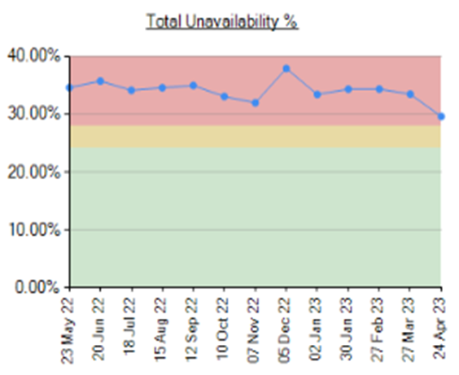
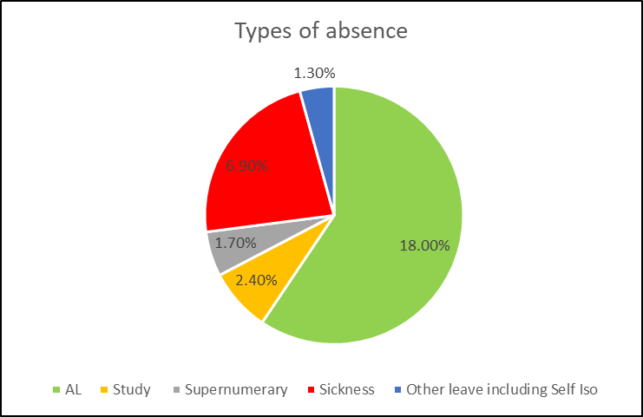
Unavailability for Registered Nurses, Midwives and Health Care Support Workers
Graph 5. Unavailability of staff
Unavailability of staff
Unavailability relates to periods of time where an employee has been given leave from their regular duties. This might be due to circumstances such as annual leave, sick leave, study leave, self isolation, carers leave etc.
The total unavailability of the workforce working time in April has remained static at 30.3% as illustrated in Graph 5.
Graph 6 illustrates the percentage breakdown of the type of unavailability. The majority of unavailability (18%) was due to planned annual leave which would have been accounted for in the department rosters however there was a high percentage of unplanned leave that would have impacted upon fill rates within the rosters. In April, sickness absence has reduced slightly to 6.9% from 7.8% in March. Additionally, 1.3% of working time was unavailable due to other leave, 2.4% was due to study leave and 1.7% was due to supernumerary time.
Graph 6. Types of absence

Slide 6
Planned versus actual staffing
Planned versus actual staffing
Graph 7 illustrates trend data for all wards reporting < 90% rota fill. The number of areas reporting <90% rota fill for registered RN/RM has decreased slightly in April with 8 areas reporting <90% fill rates compared to 10 in March. There has also been a slight decrease in the number of areas reporting <90% rota fill for HCSWs in April with 19 clinical areas reporting HCSW fill rates of <90% compared with 20 in March. The number of ward areas reporting overall fill rates of <90% in April has also decreased to 12 from 18 in March.
Appendix 1. details the exception reports for all areas reporting RN/RM fill rates of <90%.
The number of occasions that 1 critical care nurse has needed to care for more than 1 level 3 patient has decreased in April to 20 occasions compared with 54 in March. Additionally there have been 89 occasions in April where there has been no side room co-ordinator (174 in March). Any concerns with regards to critical care staffing are escalated through the senior nurse of the day. Staffing has been supported through the use of temporary workers (agency and bank), bank enhancements and registered staff (non critical care trained) are redeployed from the operational pool and clinical areas on a shift by shift basis. Critical care have opened 3 of the beds that were closed due to staffing resulting in 55 open beds rather than 59 beds. Recruitment is ongoing to the vacant positions with a plan to open the remaining 5 beds by September 2023.
Midwifery & MSW fill rate
Graph 8 illustrates that the overall fill rate for maternity has increased in April to 93.7% compared to 88.3% in March. The lowest fill rates have been seen on the Rosie Birth Centre (83%).

Slide 7
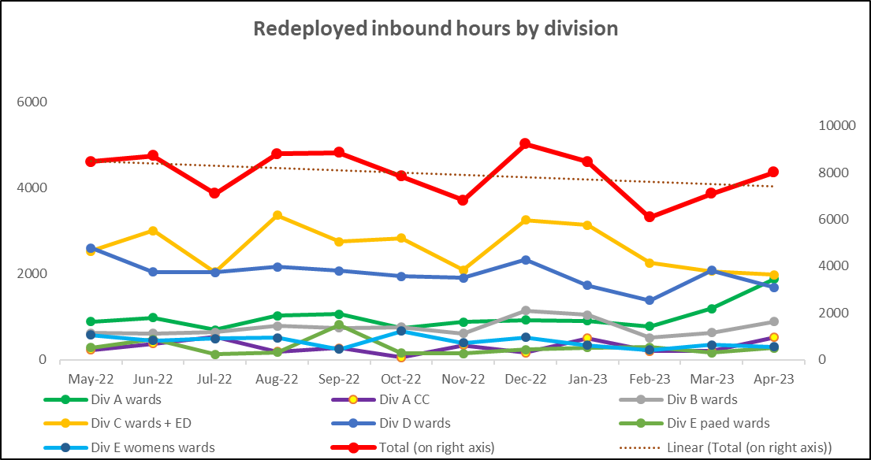
Staff deployment
Staff deployment
Graph 9 illustrates the movement of staff across wards to support safe staffing to ensure patient safety. This includes staff who are moved on an ad hoc basis (shift by shift) and shows which division they are deployed to.
The number of substantive staff redeployed has been an increasing trend over the last 2 months with an average of 258 working hours being redeployed per day in April compared with 229 hours in March. This equates to 22 long day or night shifts per day. All of these redeployments were made within the staff members own division. Staffing is also being supported by the operational pool whereby bank staff book a bank shift on the understanding that they will work anywhere in the trust where support is required.
Nursing Pipeline
Appendix 2 provides detail on the forecasted position in relation to the number of adult RN vacancies based on FTE and includes UK experienced, UK newly qualified, apprenticeship route, EU and international up to March 2024. The current forecast demonstrates a year end band 5 RN vacancy position of 11.69% which is significantly above the target of 5%. This is due in part to the reliance on international recruitment and the challenges with accommodation which has impacted upon the numbers of staff that can be deployed each month. The Trust has submitted a funding bid to NHSE to recruit an additional 20 International Nurses by the end of the year.
Appendix 3 provides detail on the forecasted position in relation to the number of Paediatric band 5 RN and HCSW vacancies up to March 2024. Numbers are based on those interviewed and offered positions in addition to planned campaigns. The current forecast demonstrates a year end band 5 Paediatric RN vacancy position of 19.12% and a band 2 HCSW position of 5.22%.
Whilst the recruitment pipeline is positive with multiple pipelines including apprenticeship routes, domestic and international recruitment, the predicted numbers are only achievable if the appropriate infrastructure is in place to support.

Slide 8
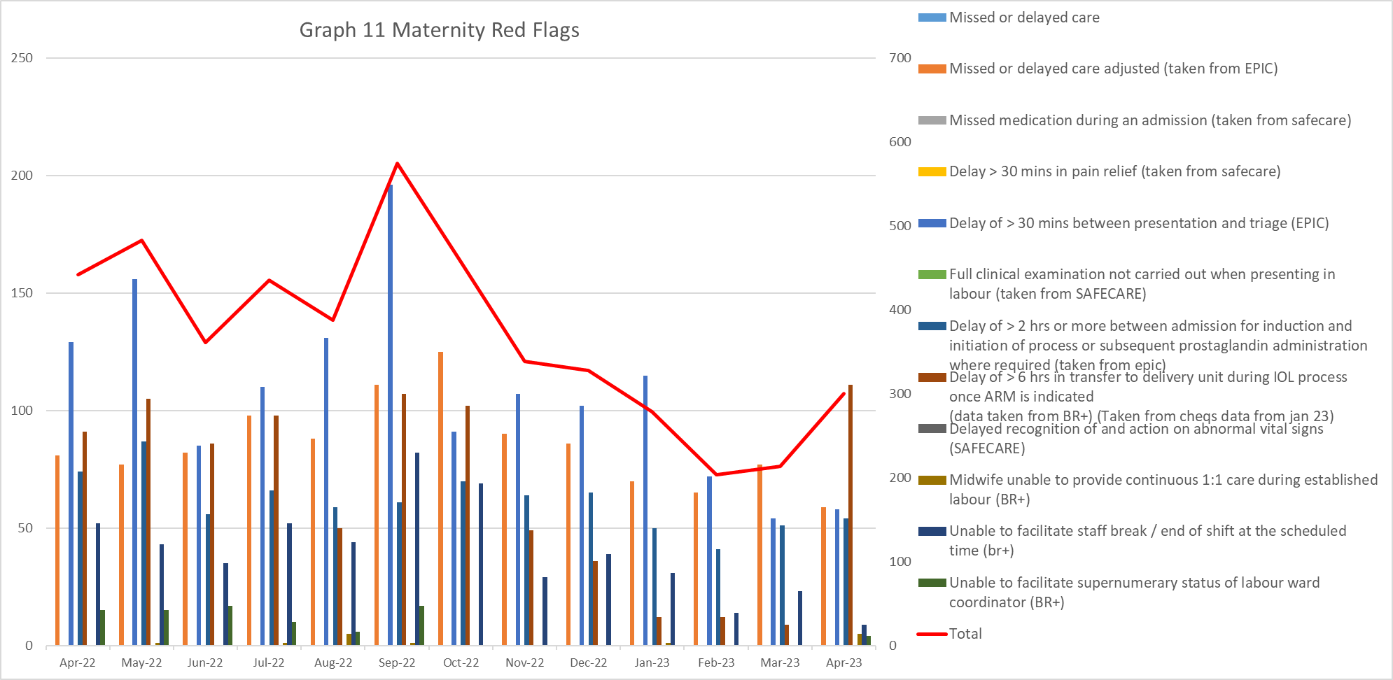
Red flags
Red Flags
A staffing red flag event is a warning sign that something may be wrong with nursing or midwifery staffing. If a staffing red flag event occurs, the registered nurse or midwife in charge of the service should be notified and necessary action taken to resolve the situation.
Nursing red flags
Graph 10 illustrates that the number of red flags reported over the last 4 months had been a decreasing trend with the exception of a spiked increase in March (333 red flags reported) compared with 214 in April. The highest number of red flags reported in April was in relation to an unmet 1:1 specialling requirement (136 compared with 171 in March). A trust wide improvement project focusing on specialling is being developed to review specialling across the organisation. Additionally, 35 red flags were reported in relation to unmet required nursing skills compared with 70 in March.
Maternity red flags
The number of maternity red flags reported over the last 6 months has been a decreasing trend with 575 reported in September compared to 300 in April. Graph 11 illustrates the red flags that have been reported. In April, 37% were due to a delay of > 6 hrs in transfer to delivery unit during the induction of labour process once ARM is indicated, 19.7% of these red flags were due to missed or delayed care and 19.3% were due to a delay of >30mins between presentation and triage.
.

Slide 9
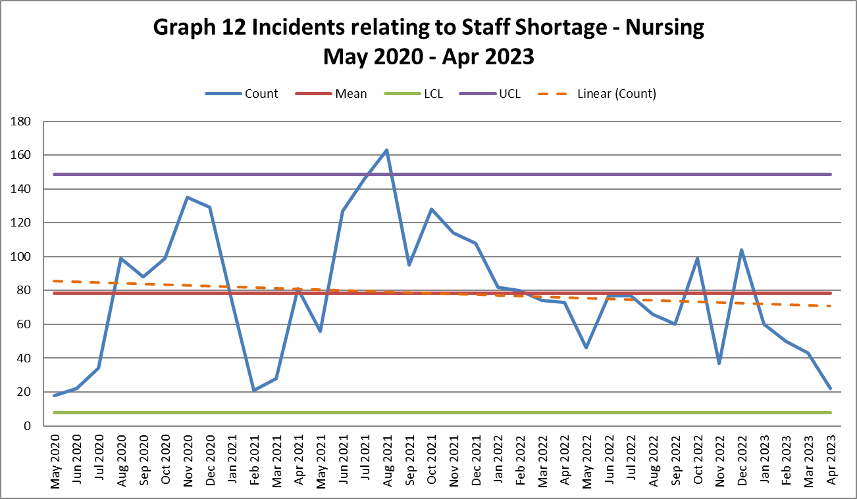
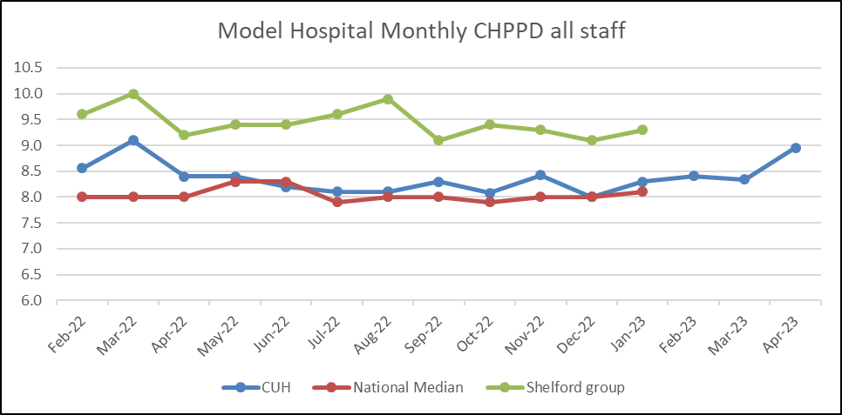
Safety and Risk
Incidents reported relating to staff shortages
Graph 12 illustrates the trend in Safety Learning Reports (SLRs) completed in relation to nurse staffing. There has been a decreasing trend over the last 4 months in the number of incidents reported relating to nurse staffing with 22 incidents reported in April.
The majority of the incidents related to staffing levels in April were reported by division D (10) with the highest reporting areas being Ward K2 (5) which has been used as a contingency area and would not have substantive staff rostered to work at night and Ward M5 (3). Division A were the second highest reporting division with 6 incidents related to staffing levels reported in April. The staffing incidents reported were spread across the division. Safety continues to be monitored through the site safety meetings.
Care hours per patient day (CHPPD)
Care hours per patient day (CHPPD) is the total number of hours worked on the roster (clinical staff including AHPs) divided by the bed state captured at 23.59 each day. NHS Improvement began collecting care hours per patient day formally in May 2016 as part of the Carter Programme. All Trusts are required to report this figure externally.
CUH CHPPD recorded for April has increased slightly to 9.0 which is comparable to other Shelford hospitals (9.3).
In maternity, from 1 April 2021, the total number of patients now includes babies in addition to transitional care areas and mothers who are registered as a patient. CHPPD for the delivery unit in April has increased to 16.6 from 14.21 in March.
Graph 13: Care Hours Per Patient Day (CHPPD)

Slide 10
Bank Fill Rate and Agency Usage
Graph 14 Registered RN/RM Bank fill rate per week
Bank fill rate
The Trust’s Staff Bank continues to support the clinical areas with achieving safe staffing levels. Graph 14 and 15 illustrate the trends in bank shift fill rate per week. Overall we have seen an increase in bank shift requests for registered staff over the last 6 months to mitigate those areas who have less than a rota fill of 90% or to cover an unmet specialling need. The number of requests for registered staff is an average of 2327 shifts per week requested and an average bank fill rate of 80.6%.
The number of requests for Health care support workers and Maternity support workers remains high with an average of 2076 shifts per week requested and an average bank fill rate of 68.6%.
In addition to bank workers we have the equivalent of 37.4 WTE agency workers working across the divisions to support staffing challenges in the short term.
Short term pay enhancements for bank shifts have been put in place in areas where we are looking to encourage a higher uptake of shifts. These bank enhancements are reviewed regularly (at least on a 6 weekly basis) through the weekly bank enhancement meeting and are for fixed periods of time.
Graph 15 HCSW/MSW bank fill rate per week

Slide 11
Appendix 1: Exception report by Division
Division A | % fill registered | % fill care staff | Overall filled % | CHPPD | Analysis of gaps | Impact on Quality / outcomes | Actions in place
L2 overnight stay | 83% | 60% | 74% | 15.90 | Sickness in B5 & 6 team with x2 B6 also leaving as promoted within trust. X3 HCAs off also. | Increased nursing and HCA workload, ability to discharge quickly could be impacted. | 08:15 nursing bronze to allocate staffign resource safely. Band 7 also worked clinically. Supprt form HR regaridng sickness management Not used as contigency (not required), post Jr Dr strike
D4 | 83% | 104% | 88% | 22.47 | Limited GPIC breaches- lowest since start of 2023, low acuity with a high number number of L2s. Bed capacity increased to 54 beds from 52 | GPIC breaches (though number this months has been lowest since start of 2023 Impact on nurse workload and quality of care provided when breaching. | Discuss at 08:15 and mitigated within units first and if required. Could pull from PD or Crit Care CNSs but does not appear that this was required. Need to cancel shift out to bank if not required- will request matron retrospective review
JOHN FARMAN ICU | 90% | 88% | 89% | 27.23 | Limited GPIC breaches- lowest since start of 2023, low acuity with a high number number of L2. Bed capacity increased to 54 beds from 52
NCCU | 89% | 94% | 90% | 27.53 | Limited GPIC breaches- lowest since start of 2023, low acuity with a high number number of L2s. Bed capacity increased to 54 beds from 52
OIR | 89% | 97% | 90% | 31.12 | Highest CHPPD delivered Trust wide. Jr doctor strike 11-15th April so reduction in elective work- need to cancel shifts that week if not required ? This affected calc | Ability to care for post op elective patients, affect on RN workload | Reviewed early by Theatre matrons. Allocation of OIR cases adjusted if required and as a last resort. Support form recovery team, request support from Crit Care (with RN skills or level 2 beds if anticpated) +/- Ops centre if requried
Division E | % fill registered | % fill care staff | Overall filled % | CHPPD delivered | Analysis of gaps | Impact on Quality / outcomes | Actions in place
C2 | 87% | 95% | 88% | 11.08 | Current shortfall of 9.37 WTE RN vacancy , 2.04 WTE band 6 vacancy and 7.33 WTE band 5 vacancy. 10 WTE pipeline in. 0 WTE pipeline out. Net positon 0.63 WTE RN | no impact on NQM ,patient experience feedback. Impact on staff wellbeing as reported by senior team. Skill concerns due to chemotherapy competence. | Three times review a day of occupancy and staffing. Support from CPFand PD , CPF supported to be supernumary to support new starters.
PICU | 70% | 88% | 71% | 32.36 | Current shortfall of 21.52 WTE RN vacancy , 3.95 WTE band 7 vacancy, 8.17 WTE band 6 vacancy and 9.40 WTE band 5 vacancy. 10 WTE pipeline in. 0 WTE pipeline out. Net positon 11.52 WTE RN | Increased pressure on QIS staff to support junior team. Unit has had a normal occupancy level for April. Positive patient experience feedback. Psychological support for team maintained with plan to increase psychology in PICU. X2 newly appointed band 7's - newly designed roles. | Three times review a day of occupancy and staffing. Rate 3 for all staff.
Rosie Birth Centre | 81% | 92% | 83% | 20.03 | Current Vacancy 2 WTE RM and 0.95 WTE MCA due to secondment. | Staffing reviewed to ensure safe care, Staff moved within service to provide safe staffing. | Regular assessment by manager of the day & matron to ensure service requirements are met.

Slide 12
Appendix 2: Adult RN Recruitment pipeline
Adult band 5 RN position based on predictions and established FTE
Month | UK based exp. applicants | Anglia Ruskin NQ (60% of graduates) | Other NQ | NAP | Overseas | Total New Starters | Leavers FTE | Promotions and transfer out of scope- retained by the trust | Staff in post FTE | ESR Establishment FTE | Vacancy rate based on established FTE | No. of vacancies based on established FTE | Starter leaver variance
Apr-23 | 5 | 2 |  | 12 | 9 | 28 | 9 | 11 | 1534 | 1699 | 9.70% | 164.87 | 19
May-23 | 1 | 3 |  | 5 | 12 | 21 | 15 | 7 | 1533 | 1699 | 9.76% | 165.87 | 6
Jun-23 | 3 |  |  |  | 18 | 21 | 14.4 | 13 | 1527 | 1738 | 12.14% | 210.97 | 6.6
Jul-23 | 6 |  |  |  | 20 | 26 | 24 | 14 | 1515 | 1806 | 16.14% | 291.57 | 2
Aug-23 | 5 |  |  |  | 20 | 25 | 15 | 4 | 1521 | 1806 | 15.81% | 285.57 | 10
Sep-23 | 3 |  |  |  | 25 | 28 | 18 | 14 | 1517 | 1826 | 16.95% | 309.57 | 10
Oct-23 | 5 | 20 | 8 |  | 30 | 63 | 19 | 20 | 1541 | 1826 | 15.64% | 285.57 | 44
Nov-23 | 3 |  |  | 21 | 30 | 54 | 18 | 14 | 1563 | 1826 | 14.43% | 263.57 | 36
Dec-23 | 2 |  |  |  | 40 | 42 | 18 | 15 | 1572 | 1826 | 13.94% | 254.57 | 24
Jan-24 | 2 |  |  |  | 40 | 42 | 18 | 15 | 1581 | 1826 | 13.45% | 245.57 | 24
Feb-24 | 6 |  |  |  | 30 | 36 | 18 | 15 | 1584 | 1826 | 13.28% | 242.57 | 18
Mar-24 | 5 | 20 | 7 |  | 30 | 62 | 18 | 15 | 1613 | 1826 | 11.69% | 213.57 | 44
TOTAL | 46 | 45 | 15 | 38 | 304 | 448 | 204.4 | 157 | 1613 | 1826 | 11.69% | 213.57 | 243.6

Slide 13
Appendix 3: Paediatric RN and Band 2 HCSW Recruitment pipeline
Paediatric band 5 RN position based on predictions and established FTE
Month | UK based exp. applicants | Anglia Ruskin NQ | Other NQ | Overseas | Total New Starters FTE | Leavers FTE (based on leavers in the last 12 months) | Promotions and transfer out of scope- retained by the trust | Staff in post FTE | ESR Establishment FTE | Vacancy rate based on established FTE | No. of vacancies based on established FTE | Starter leaver variance
Apr-23 | 1 |  |  |  | 3 | 2 | 0 | 164.39 | 213.73 | 23.09% | 49.34 | 1
May-23 |  |  |  |  | 0 | 1 | 1 | 162.39 | 213.73 | 24.02% | 51.34 | -1
Jun-23 | 2 | 2 |  |  | 4 | 3 | 1 | 162.39 | 213.73 | 24.02% | 51.34 | 1
Jul-23 | 1 |  |  | 1 | 2 | 2 | 1 | 161.39 | 213.73 | 24.49% | 52.34 | 0
Aug-23 |  |  | 1 | 2 | 3 | 2 | 2 | 160.86 | 213.73 | 24.74% | 52.87 | 1.47
Sep-23 | 1 |  | 1 | 2 | 4 | 2 | 1 | 161.86 | 213.73 | 24.27% | 51.87 | 2
Oct-23 | 2 | 8 | 11 | 2 | 23 | 5 | 2 | 177.86 | 213.73 | 16.78% | 35.87 | 18
Nov-23 | 1 | 8 | 2 | 2 | 13 | 5 | 3 | 182.86 | 213.73 | 14.44% | 30.87 | 8
Dec-23 | 1 |  |  |  | 1 | 6 | 1 | 176.86 | 213.73 | 17.25% | 36.87 | -5
Jan-24 |  |  | 1 | 2 | 3 | 4 | 1 | 174.86 | 213.73 | 18.19% | 38.87 | -1
Feb-24 | 2 |  |  | 2 | 4 | 5 | 1 | 172.86 | 213.73 | 19.12% | 40.87 | -1
Mar-24 | 2 |  |  | 2 | 4 | 3 | 1 | 172.86 | 213.73 | 19.12% | 40.87 | 1
TOTAL | 13 | 18 | 16 | 15 | 64 | 39.53 | 15 | 172.86 | 213.73 | 19.12% | 40.87 | 1
Band 2 HCSW position based on predictions and established FTE
Month | UK based applicants | Apprenticeship (direct entry) | Total New Starters FTE | Leavers FTE | Staff in post FTE | ESR Establishment FTE | Vacancy rate based on established FTE | No. of vacancies based on established FTE
Apr-23 | 18 | 1 | 19 | 18 | 768 | 887 | 13.43% | 119
May-23 | 20 |  | 20 | 20 | 768 | 887 | 13.43% | 119
Jun-23 | 20 |  | 20 | 15 | 773 | 910 | 15.10% | 137
Jul-23 | 30 |  | 30 | 16 | 787 | 958 | 17.90% | 172
Aug-23 | 30 |  | 30 | 15 | 802 | 958 | 16.34% | 157
Sep-23 | 30 |  | 30 | 15 | 817 | 968 | 15.65% | 152
Oct-23 | 30 | 14 | 44 | 15 | 846 | 968 | 12.66% | 123
Nov-23 | 30 |  | 30 | 15 | 861 | 968 | 11.11% | 108
Dec-23 | 30 |  | 30 | 15 | 876 | 968 | 9.56% | 93
Jan-24 | 30 |  | 30 | 18 | 888 | 968 | 8.32% | 81
Feb-24 | 30 |  | 30 | 15 | 903 | 968 | 6.77% | 66
Mar-24 | 30 |  | 30 | 15 | 918 | 968 | 5.22% | 51
TOTAL | 328 | 15 | 343 | 192 | 917.84 | 968.4 | 5.22% | 50.56

