Slide 1
Monthly Nurse Safe Staffing
Sponsoring executive director: Lorraine Szeremeta, Chief Nurse
Amanda Small Deputy, Chief Nurse
Sarah Raper, Project Lead Nurse safe staffing
Board of Directors: 8 February 2023

Slide 2
Executive Summary
This slide set provides an overview of the Nursing and Midwifery staffing position for December 2022.
The vacancy position has increased slightly in December for Health Care Support Workers (HCSW’s) to 13.8% from 12.9% in November and maternity care assistants (MCA’s) to 18.0% from 17.3% in November. Conversely, the vacancy rate for registered children's nurses has decreased to 17.3% from 20.1% in November. This is explained in part due to the review of paediatric vacancies to ensure that all vacancies across paediatric areas are categorised correctly within ESR. The vacancy position for Registered Midwifes (RM’s) has also decreased to 2.67% from 2.9% in November. The vacancy rate for Registered Nurses (RN’s) has remained relatively static at 8.8% compared to 8.7% in November.
Turnover rate remains high at 12.8% for RN’s, 11.1% for RM’s, 14.7% for RSCN’s and 18.0% for HCSW’s. The main reason for leaving for RN’s, HCSW’s and RSCN’s is voluntary resignation – relocation whereas for RM’s it is cited as being due to Voluntary resignation – work/life balance and voluntary resignation – relocation.
The planned versus actual staffing report demonstrates that 19 clinical areas reported <90% overall rota fill in December. The overall fill rate for maternity has decreased slightly to 88.4% compared to 91.4% in November. The total unavailability of the workforce working time in December has increased to 34.5% from 28.2% in November. The majority of unavailability (17.4%) is due to planned annual leave, sickness absence has increased to 11.2% compared with 8.1% in November. Additionally, 2.2% of working time was unavailable due to other leave which is a slight increase from November (1.6%), 2.2% was due to study leave and 1.5% was due to supernumerary time.
In order to mitigate staffing risks, the number of requests for bank workers remains high with an average of 2151 shifts per week requested for registered staff and 2177 shifts requested for Health care support workers and Maternity support workers per week with an average bank fill rate of 64.9% for registered staff and 56.4% for Health Care Support workers. In addition, the equivalent of 41.3WTE agency workers are working across the divisions. Despite this, redeployment of nurses and midwives has remained necessary due to staff unavailability, with an average of 297 working hours being redeployed each day of which 98.3% of the redeployed hours have been within division.
There has been a significant increase in the number of occasions that 1 critical care nurse has needed to care for more than 1 level 3 patient in December (235 occasions compared to 50 in November). Additionally there have been 214 occasions where there has been no side room co-ordinator (131 in November). This has been due to high unavailability of staff (sickness) and high acuity of patients. Any concerns with regards to critical care staffing are escalated through the senior nurse of the day. Critical care bed capacity remains at 52 beds rather than 59 beds whilst recruitment is ongoing to the vacant positions however it has been necessary to open an additional bed at times to support capacity.

Slide 3
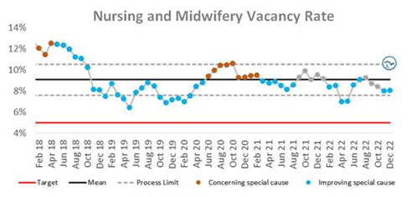
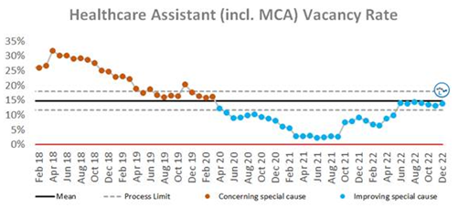
Combined Nursing and Midwifery Staffing Position Vacancy Rates
Graph 1. Nursing and midwifery vacancy rates
Vacancy position
The combined vacancy rate for Registered Nurses (RNs) and Registered Midwives (RMs) has remained relatively static at 8.1% compared to 8.0% in November. The vacancy rate for Health care support workers (HCSW’s) (including Maternity Care Assistants (MCA’s) has increased slightly to 14% compared to 13.1% in November. When broken down further into Nursing and Midwifery specific vacancies, the MCA workforce vacancy rate has increased slightly from 17.3% in November to 18.0% in December. The HCSW vacancy rate (excl MCA) has also increased slightly to 13.8% from 12.9% in November.
The HCSW (including MCAs) turnover rate remains high at 18.0%. The main reason for HCSWs leaving remains voluntary resignation – relocation (31%) and the next highest reason is voluntary resignation – work life balance (25.5%). The leavers destination is unknown for the majority of HCSWs (49%), 15.3% of HCSWs are leaving to take up employment in other NHS organisations and 14.4% are leaving for no employment.
Graph 2. Healthcare Assistant vacancy rates

Slide 4
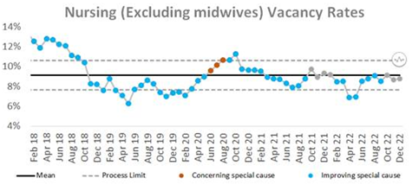
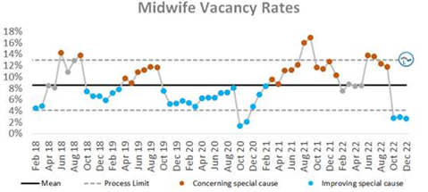
Staffing Position Vacancy Rates for Registered Nurses and Registered Midwives
Graph 3. Registered Nurse vacancy rates
Vacancy position
The vacancy rate for Registered Nurses working in adult areas has remained relatively static at 8.8% compared to 8.7% in November. The vacancy rate for registered children's nurses has decreased to 17.3% from 20.1% in November. This is explained in part due to the review of paediatric vacancies to ensure that all vacancies across paediatric areas are categorised correctly.
The vacancy rate for Registered Midwives illustrates a sharp increase in Graph 4 in June however this was due to the work that had been undertaken to align the workforce Electronic Staff Record (ESR) and financial ledger to reflect the additional approved investment in maternity workforce. The actual vacancy rate had remained static for a number of months. Over the last 3 months, there has been a decreasing trend in the vacancy rate from 13.0% in July to 2.67% in December.
The turnover rate in December remains high at 12.8% for RNs in adult areas (13.2% in November), 14.7% for Registered Children's Nurses (15.1% in November) and 11.1% for RMs (12.2% in November). The main reasons for RMs leaving is voluntary resignation – work life balance (24.1%) and voluntary resignation – relocation (24.1%). The main reason for RNs leaving is voluntary resignation – relocation (51.4%). The leavers destination data demonstrates that 33.6% of RNs and 41.4% of RMs are leaving to take up employment in other NHS organisations. 24.1% of RMs are leaving for no employment compared with 6.4% of RNs.
Graph 4. Registered Midwife vacancy rates

Slide 5
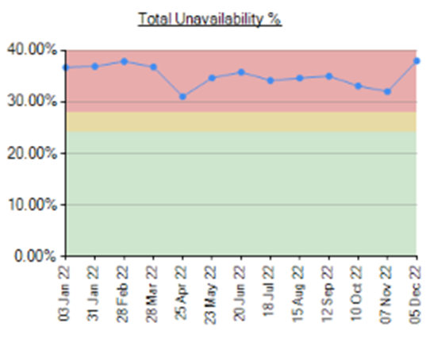
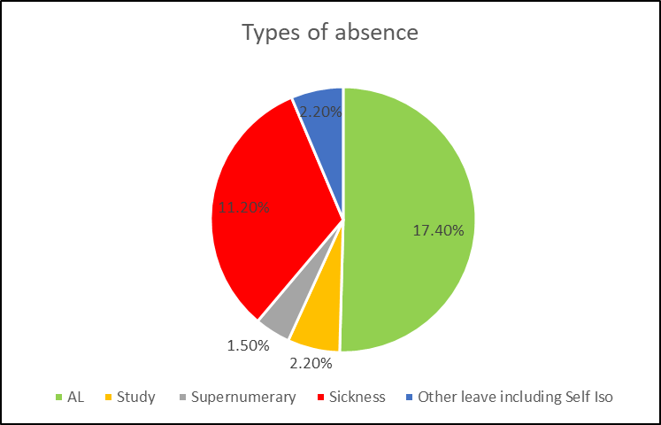
Unavailability for Registered Nurses, Midwives and Health Care Support Workers
Graph 5. Unavailability of staff
Unavailability of staff
Unavailability relates to periods of time where an employee has been given leave from their regular duties. This might be due to circumstances such as annual leave, sick leave, study leave, self isolation, carers leave etc.
The total unavailability of the workforce working time in December has increased to 34.5% from 28.2% in November as illustrated in Graph 5.
Graph 6 illustrates the percentage breakdown of the type of unavailability. The majority of unavailability (17.4%) was due to planned annual leave which would have been accounted for in the department rosters however there was a high percentage of unplanned leave that would have impacted upon fill rates within the rosters. In December, sickness absence has increased to 11.2% compared with 8.1% in November. Additionally, 2.2% of working time was unavailable due to other leave which is a slight increase to November (1.5%), 2.2% was due to study leave and 1.5% was due to supernumerary time.
Graph 6. Types of absence

Slide 6
Planned versus actual staffing
Planned versus actual staffing
Graph 7 illustrates trend data for all wards reporting < 90% rota fill. The number of areas reporting <90% rota fill for registered RN/RM has increased significantly in December with 16 areas reporting <90% fill rates compared to 3 in November. There has also been an increase in the number of areas reporting <90% rota fill for HCSWs in December with 25 clinical areas reporting HCSW fill rates of <90% compared with 18 in November. The number of ward areas reporting overall fill rates of <90% in December has also increased to 19 from 7 in November.
Division A reported the most areas (5) with overall fill rates of <90%. Appendix 1. details the exception reports for all areas reporting fill rates of <90%.
There has been a significant increase in the number of occasions that 1 critical care nurse has needed to care for more than 1 level 3 patient in December (235 occasions compared to 50 in November). Additionally there have been 214 occasions where there has been no side room co-ordinator (131 in November). This has been due to high unavailability of staff (sickness) and high acuity of patients. Any concerns with regards to critical care staffing are escalated through the senior nurse of the day. Staffing has been supported through the use of temporary workers (agency and bank), bank enhancements and registered staff (non critical care trained) are redeployed from the operational pool and clinical areas on a shift by shift basis. Critical care bed capacity remains at 52 beds rather than 59 beds whilst recruitment is ongoing to the vacant positions however it has been necessary to open an additional bed at times to support capacity.
Midwifery & MSW fill rate
Graph 8 illustrates that the overall fill rate for maternity has decreased slightly in December to 88.4% compared to 91.4% in November. The lowest fill rates have been seen on the Rosie Birth Centre (73%).

Slide 7
Staff deployment
Staff deployment
Graph 9 illustrates the movement of staff across wards to support safe staffing to ensure patient safety. This includes staff who are moved on an ad hoc basis (shift by shift) and shows which division they are deployed to.
The number of substantive staff redeployed in December has increased slightly with an average of 297 working hours being redeployed per day compared with 220 hours in November. This equates to 26 long day or night shifts per day. The majority of redeployments are within division (98.3% compared to 1.7% of staff who are deployed outside of their division). Staffing is also being supported by the operational pool whereby bank staff book a bank shift on the understanding that they will work anywhere in the trust where support is required.
Nursing Pipeline
Appendix 2 provides detail on the forecasted position in relation to the number of adult RN vacancies based on FTE and includes UK experienced, UK newly qualified, apprenticeship route, EU and international recruits up to March 2023. The current forecast demonstrates a year end band 5 RN vacancy position of 9.23% which is above the target of 5%. This is due in part to the reliance on international recruitment and the challenges with accommodation which has impacted upon the numbers of staff that can be deployed each month. A detailed recruitment plan is being collated for all Nursing recruitment pipelines to outline what can realistically be achieved, the blockers that may prevent this and the mitigations that can be put in place to address these.
Appendix 3 provides detail on the forecasted position in relation to the number of Paediatric band 5 RN and HCSW vacancies up to March 2023. Numbers are based on those interviewed and offered positions in addition to planned campaigns. The current forecast demonstrates a year end band 5 Paediatric RN vacancy position of 21.68% and a band 2 HCSW position of 3.8%.
Whilst the recruitment pipeline is positive with multiple pipelines including apprenticeship routes, domestic and international recruitment, the predicted numbers are only achievable if the appropriate infrastructure is in place to support.

Slide 8
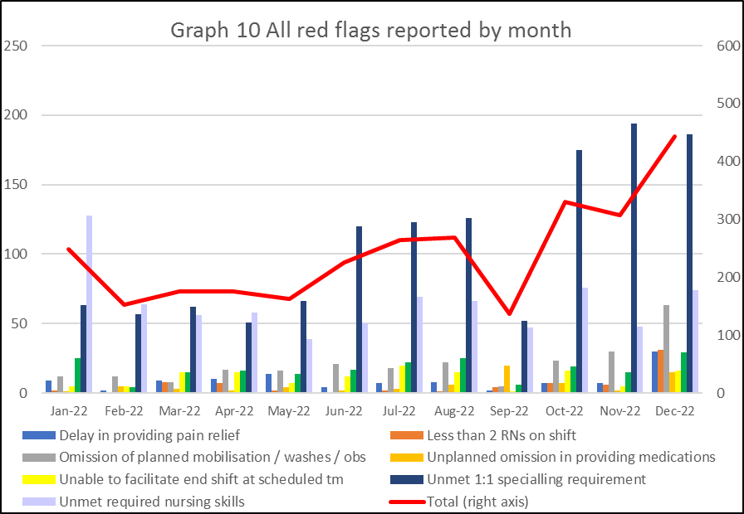
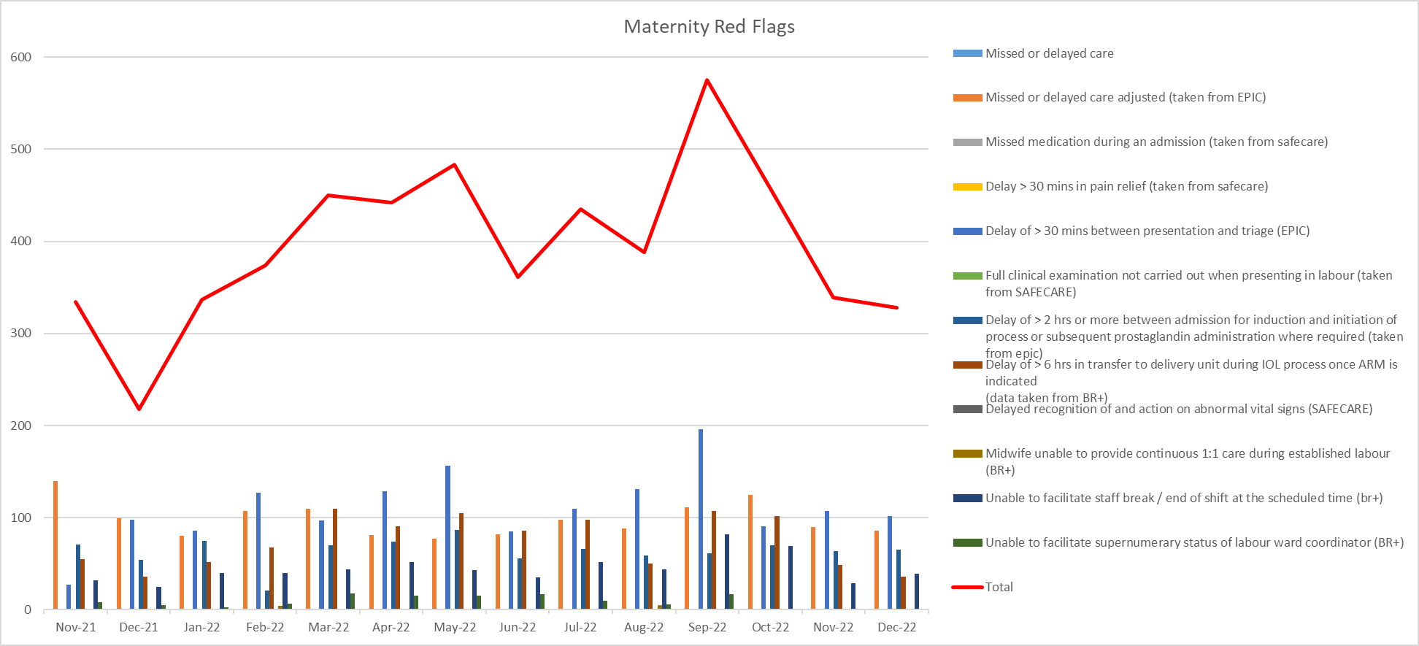
Red flags
Red Flags
A staffing red flag event is a warning sign that something may be wrong with nursing or midwifery staffing. If a staffing red flag event occurs, the registered nurse or midwife in charge of the service should be notified and necessary action taken to resolve the situation.
Nursing red flags
Graph 10 illustrates that the number of red flags reported in December has increased from 307 to 444. The highest number of red flags reported in December was in relation to an unmet 1:1 specialling requirement (186 compared with 194 in November). A trust wide improvement project focusing on specialling is being developed to review specialling across the organisation. Additionally, 63 red flags were reported in relation to omission of planned mobilisation, washes and observations compared with 30 in November.
Graph 11: Maternity Red Flags
Maternity red flags
The number of maternity red flags reported over the last 3 months has been a decreasing trend with 575 reported in September compared to 328 in December. Graph 11 illustrates the red flags that have been reported. In December, 31.1% of these red flags were due to a delay of >30mins between presentation and triage, 26.2% were due to missed or delayed care and 19.8% were due to a delay of > 2 hrs or more between admission for induction and initiation of process or subsequent prostaglandin administration where required. This is reflective of the high levels of activity and difficulty in maintaining flow.
.

Slide 9
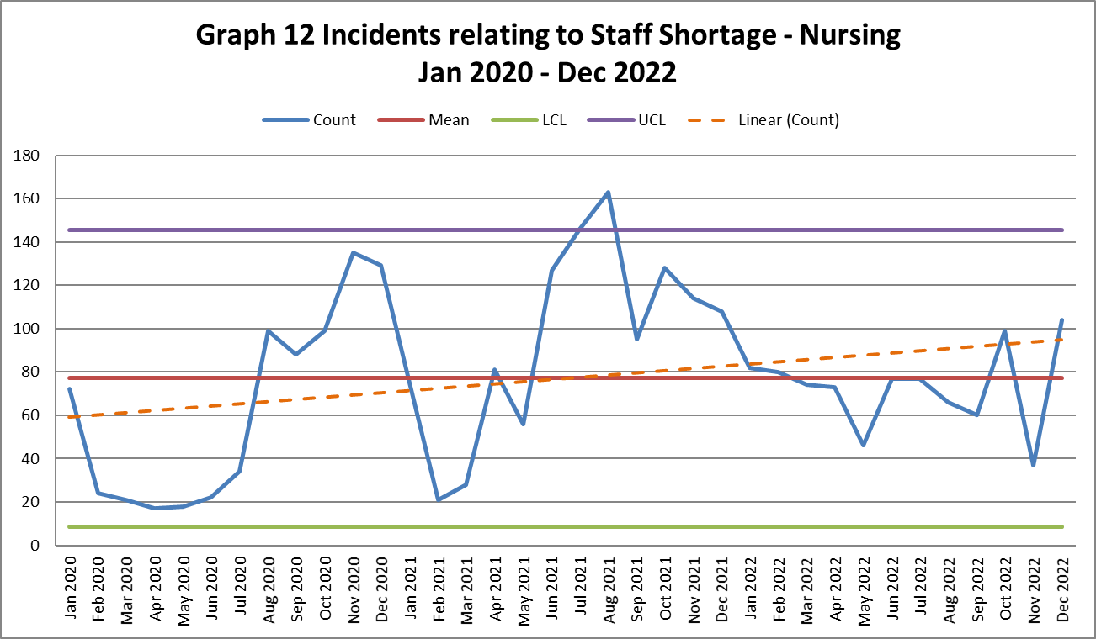
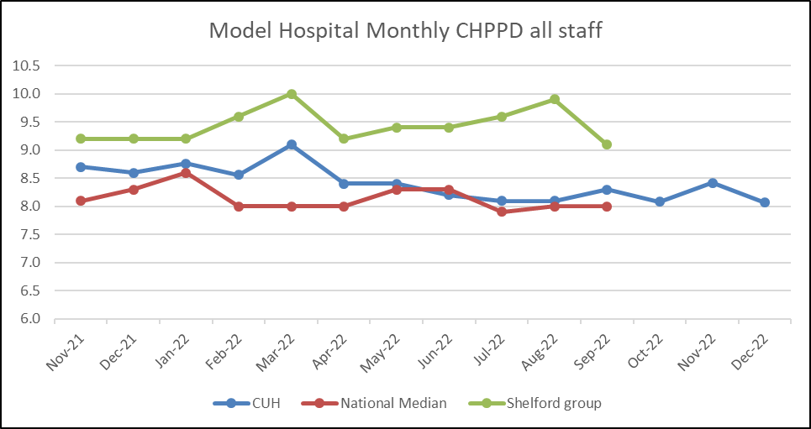
Safety and Risk
Incidents reported relating to staff shortages
Graph 12 illustrates the trend in Safety Learning Reports (SLRs) completed in relation to nurse staffing. There were 104 incidents reported relating to nurse staffing in December which has increased from the number reported in November (37).
The majority of the incidents related to staffing levels in December were reported by division C (39). Within Division C, the staffing incidents reported were spread across the division with Ward D5 and ward G4 reporting the most incidents (5 each). Division D reported 28 incidents related to staffing levels in December, the majority of which were reported across 3 ward areas (M5 8, L5 6 and D7 6). Safety continues to be monitored through the site safety meetings.
Care hours per patient day (CHPPD)
Care hours per patient day (CHPPD) is the total number of hours worked on the roster (clinical staff including AHPs) divided by the bed state captured at 23.59 each day. NHS Improvement began collecting care hours per patient day formally in May 2016 as part of the Carter Programme. All Trusts are required to report this figure externally.
CUH CHPPD recorded for December has decreased slightly to 8.1 from 8.42 in November which is comparable to the national median of 8.0 however is lower than other Shelford hospitals (9.1).
In maternity, from 1 April 2021, the total number of patients now includes babies in addition to transitional care areas and mothers who are registered as a patient. CHPPD for the delivery unit in December was 14.06 which is slightly lower than November (14.42).
Graph 13: Care Hours Per Patient Day (CHPPD)

Slide 10
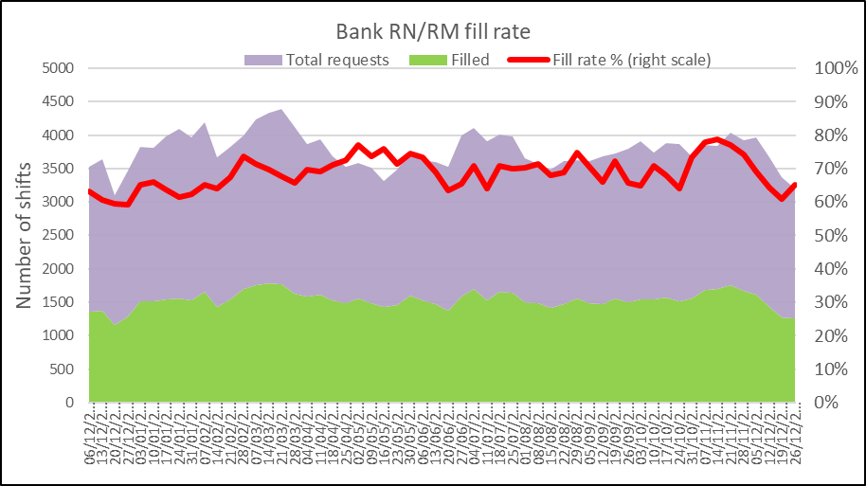
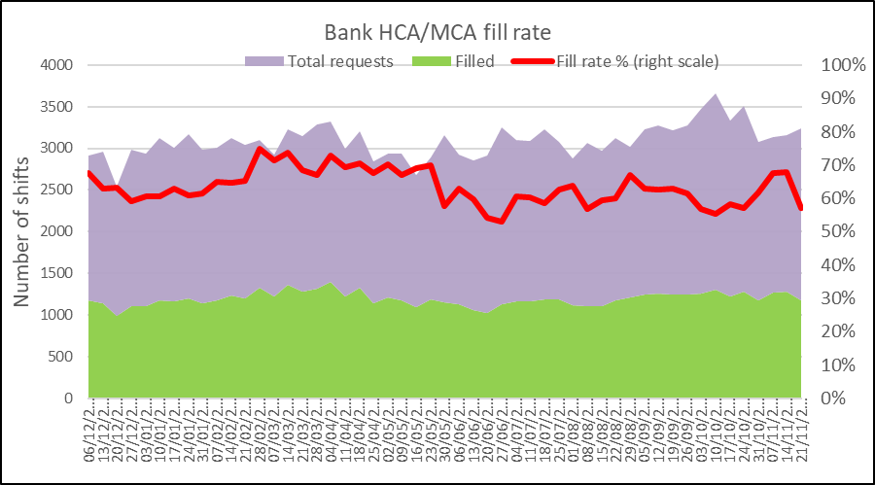
Bank Fill Rate and Agency Usage
Graph 14 Registered RN/RM Bank fill rate per week
Bank fill rate
The Trust’s Staff Bank continues to support the clinical areas with achieving safe staffing levels. Graph 14 and 15 illustrate the trends in bank shift fill rate per week. Overall we have seen an increase in bank shift requests for registered staff over the last 6 months to mitigate those areas who have less than a rota fill of 90%. The number of requests for registered staff is an average of 2151 shifts per week requested and an average bank fill rate of 64.9%.
The number of requests for Health care support workers and Maternity support workers remains high with an average of 2177 shifts per week requested and an average bank fill rate of 56.4%.
In addition to bank workers we have the equivalent of 41.3 WTE agency workers working across the divisions to support staffing challenges in the short term. This accounts for 11% of the total Nursing filled shifts.
Short term pay enhancements for bank shifts have been put in place in areas where we are looking to encourage a higher uptake of shifts. These bank enhancements are reviewed regularly (at least on a 6 weekly basis) through the weekly bank enhancement meeting and are for fixed periods of time.
Graph 15 HCSW/MSW bank fill rate per week

Slide 11
Appendix 1: Exception report by Division – Division A
Division A | % fill registered | % fill care staff | Overall filled % | CHPPD | Analysis of gaps | Impact on Quality / outcomes | Actions in place
C8 | 85% | 83% | 84% | 6.43 | 10.29 HCSW vacancies 11.46 RN vacancies 1 B6 Vacancy. 3 WTE pipeline in HCSW 1.00 B5 pipeline in. High Number of enhanced observations and increased sickness dec 23. | Delays to patient care and patient flow. Reduced supervisory time. Reduction NQM and KPI's. Staff morale, retention of staff. | C8 O staff listening events. 0815 Nursing bronze with band 7 and Matron oversight. Escacaltion to site safety. Mitigation in place within division when staffing allows. Matron of the day for division for support and escalation.
D8 | 89% | 101% | 94% | 8.05 | 9.10 HCSW vacancies. Sickness levels in Dec high with higher number of patients requiring enhanced observations. Movement of staff within division to mitigate risks. | Delays to patient care and patient flow. Reduced supervisory time. Reduction NQM and KPI's. Staff morale, retention of staff. | Level 8 listening events. 0815 Nursing bronze with band 7 and Matron oversight. Escacaltion to site safety. Mitigation in place within division when staffing allows. Matron of the day for division for support and escalation.
L2 overnight stay | 66% | 36% | 55% | 3.45 | Minimal vacancies. Reliant on bank to support contingency of 4 to 12 patients. Not always filled or staff moved from L2 DSU leaving an RN and HCSW gap. | Delays to patient care and patient flow. Reduced supervisory time. Reduction NQM and KPI's. Staff morale, retention of staff. Poor patient experience. | 1615 Nursing bronze with band 7 and Matron oversight. Escacaltion to site safety. Mitigation in place within division when staffing allows. Matron of the day for division for support and escalation.
L4 | 90% | 94% | 91% | 6.24 | Sickness and acuity of patients. 1 patient requiring level 1 + care and 1:1 RN support. LLOS patient. Complex needs. IF patients placed on Level 4 ATC due to acuity on C7. | Delays to patoent care and patient flow. Reduced supervisory time. Reduction NQM and KPI's. Staff morale,retention of staff. Poor patient experience. | 1615 Nursing bronze with band 7 and Matron oversight. Escacaltion to site safety. Mitigation in place within division when staffing allows. Matron of the day for division for support and escalation.
M4 | 90% | 93% | 91% | 6.06 | Sickness and acuity of patients. IF patients placed on Level 4 ATC due to acuity on C7. | Delays to patoent care and patient flow. Reduced supervisory time. Reduction NQM and KPI's. Staff morale,retention of staff. Poor patient experience. | 1615 Nursing bronze with band 7 and Matron oversight. Escacaltion to site safety. Mitigation in place within division when staffing allows. Matron of the day for division for support and escalation.
D4 | 81% | 89% | 83% | 19.92 | High level of acuity and level 3 and 2 patients. Delayed step downs from CC to ward beds. 6.16 RN 5.16 WTE piepline in. | GPIC Breaches. Delays to patoent care and patient flow. Reduced supervisory time. Reduction NQM and KPI's. Staff morale,retention of staff. Poor patient experience. Lack of abilty to be pre emptive due to clinical acuity. | 1615 Nursing bronze with band 7 and Matron oversight. Escacaltion to site safety. Mitigation in place within division when staffing allows. Matron of the day for division for support and escalation.
JOHN FARMAN ICU | 80% | 80% | 80% | 24.76 | 19.15 RN 3.75 with pipeline High level of acuity and level 3 and 2 patients. Delayed step downs from CC to ward beds. | GPIC Breaches. Delays to patoent care and patient flow. Reduced supervisory time. Reduction NQM and KPI's. Staff morale,retention of staff. Poor patient experience. Lack of abilty to be pre emptive due to clinical acuity. | 1615 Nursing bronze with band 7 and Matron oversight. Escacaltion to site safety. Mitigation in place within division when staffing allows. Matron of the day for division for support and escalation.
NCCU | 77% | 75% | 76% | 25.26 | 34.24 24.24 Pipeline in. Acuity level 3 and l3vel 2 patients. Delayed step down from CC. High SST's. | GPIC Breaches. Delays to patoent care and patient flow. Reduced supervisory time. Reduction NQM and KPI's. Staff morale,retention of staff. Poor patient experience. Lack of abilty to be pre emptive due to clinical acuity. | 1615 Nursing bronze with band 7 and Matron oversight. Escalation to site safety. Mitigation in place within division when staffing allows. Matron of the day for division for support and escalation.

Slide 12
Appendix 1: Exception report by Division – Division C and D
Division C | % fill registered | % fill care staff | Overall filled % |  | Analysis of gaps | Impact on Quality / outcomes | Actions in place
N2 | 86% | 82% | 85% | 7.44 | RN vacancy = 1.12wte with 3 non-effective HCSW = no vacancies with 4.8 non-effective Staff unavailability high for sickness, annual leave above funding (RN&HCSW). Other leave high for RNs on industrial action days. High specialling load for patients in siderooms mid Bank/Agency fill rate reduced 75 RN & 99 HCSW unfilled duties in December. | resus trolley check missed - 1 day Slight decrease in overall NQM from 93.6% to 89.6%. Catheter care 66.7% and 4 metrics amber (previosuly green). No impact seen with patient harm or complaints | Division focus on adherence to sickness absence policy. Matron oversight of safe staffing levels and validation of patients requiring enhanced level observations. Daily divisional mitigation; site safety escalation; weekly prospective staffing reporting and mitigation; divisional recruitment and retention strategy. Matron quality focus.
Division D | % fill registered | % fill care staff | Overall filled % |  | Analysis of gaps | Impact on Quality / outcomes | Actions in place
A3 | 77% | 106% | 85% | 5.76 | GAPS over the course of the Rota noted with no pattern. 2 Night shifts 7th and 19th both with only 1 RN noted, staff not moved on Rota from other wards. Rapid increase in vaccancy rate behind GAPs now 4.5WTE in small team. Escalated Divisionally since September. | some increase in untoward incidents relating to care, morale is low. Staff from other areas int eh Division are expressing concern about the number of times thaey are moved internally to mitigate | full review of rostering and mitigation being carried out. Review of the role of the bleepholders. Priority given to ensuring Senior Sisters/Charge Nurses have supervisory time so they are in a better position for early mitigatation. All bank shifts to be pre-emptively sent to bank
A4 | 89% | 117% | 100% | 7.16 | GAPS over the course of the Rota noted. 2 Shifts appear to have 2 RN vaccancies, with staff not moved on the ROTA. GAPS caused by increase in sickness, vaccancies and 5 RN's on Maternity Leave. | some increase in untoward incidents relating to care, skill mix issues. Morale is low. Staff from other areas int eh Division are expressing concern about the number of times thaey are moved internally to mitigate | full review of rostering and mitigation being carried out. Review of the role of the bleepholders. Priority given to ensuring Senior Sisters/Charge Nurses have supervisory time so they are in a better position for early mitigatation. All bank shifts to be pre-emptively sent to bank
J2 | 89% | 152% | 114% | 7.31 | GAPS over the course of the ROTA, caused by increase in sickness, maternity leave and vacancies. This has been escalated Divisionally since August by Ward Manager. | morale is low and bank staff are reluctant to book in | as above. Explore ways to better orientate and support, bank staff

Slide 13
Appendix 1: Exception report by Division – Division E
Division E | % fill registered | % fill care staff | Overall filled % | CHPPD delivered | Analysis of gaps | Impact on Quality / outcomes | Actions in place
PICU | 81% | 107% | 83% | 26.00 | Current shortfall of 23.11 WTE with 10.9 WTE pipeline in, 13.53 Band 6 QIS RN vacancy , 4.48 WTE band 5 vacancy. Promotions to band 6 after bridging course | increased pressure on QIS staff to support junior team. Positive patient experience feedback. Challenges with practice development due to PICU course and sickness.Development days continue. Psychological support for team maintained with plan to increase psychology in PICU. | Three times review a day of occupancy and staffing. Rate 3 plus for all staff. Plan for support from the ODN to support repatriation , band 5 -6 bridging the gap development resulted in offers to 6 new band 6's.
Rosie Birth Centre | 75% | 67% | 73% | 13.31 | number of new starter midwives on SN shifts and maternity leave/sickness 5.9% | risk to needing to temporarily close the RBC due to staffing numbers | New starters will come to this area although they will initially be required to work SN shifts
Sara Ward | 89% | 68% | 81% | 4.92 | number of new starter MW's remaining on SN shifts, sickness of 13.4% | delays to IOL and providing care to women in early labour on the ward | sickness management and support for new starter IR midwives on extended SN shifts

Slide 14
Appendix 2: Adult RN Recruitment pipeline
Adult band 5 RN position based on predictions and established FTE
Month | UK based exp. applicants | Anglia Ruskin NQ (60% of graduates) | Other NQ | NAP | Overseas | Total New Starters | Leavers FTE | Promotions and transfer out of scope- retained by the trust | Staff in post FTE | ESR Establishment FTE | Vacancy rate based on established FTE | No. of vacancies based on established FTE
Apr-22 | 7 |  |  |  | 25 | 32 | 15 | 14 | 1584 | 1768 | 10.41% | 184.12
May-22 | 8 |  |  | 17 | 20 | 45 | 25 | 7 | 1597 | 1768 | 9.67% | 171
Jun-22 | 1 |  |  |  | 23 | 24 | 14.4 | 13 | 1594 | 1768 | 9.86% | 174.4
Jul-22 | 6 |  |  | 9 | 29 | 44 | 24 | 14 | 1600 | 1768 | 9.52% | 168.4
Aug-22 | 5.2 |  | 0.45 |  | 23 | 29 | 22.6 | 4 | 1591 | 1699 | 6.33% | 107.47
Sep-22 | 3 | 10 |  | 0 | 22 | 35 | 18 | 14 | 1594 | 1699 | 6.15% | 104.47
Oct-22 | 3 | 2 | 6 |  | 12 | 23 | 19 | 13 | 1585 | 1699 | 6.68% | 113.47
Nov-22 | 3 | 1 |  |  | 13 | 17 | 10 | 26 | 1566 | 1699 | 7.80% | 132.47
Dec-22 | 5 | 1 |  | 20 | 5 | 31 | 15 | 12 | 1570 | 1699 | 7.59% | 128.87
Jan-23 | 3 |  |  | 2 | 21 | 26 | 18 | 15 | 1563 | 1699 | 8.00% | 135.87
Feb-23 | 4 | 1 |  |  | 10 | 15 | 18 | 15 | 1545 | 1699 | 9.06% | 153.87
Mar-23 | 5 | 5 | 5 |  | 15 | 30 | 18 | 15 | 1542 | 1699 | 9.23% | 156.87
TOTAL | 53 | 20 | 11 | 48 | 218 | 351 | 217 | 162 | 1542 | 1698.95 | 9.23% | 156.87

Slide 15
Appendix 3: Paediatric RN and Band 2 HCSW Recruitment pipeline
Paediatric band 5 RN position based on predictions and established FTE
Month | UK based exp. applicants | Anglia Ruskin NQ | Other NQ | Overseas | Total New Starters FTE | Leavers FTE (based on leavers in the last 12 months) | Promotions and transfer out of scope- retained by the trust | Staff in post FTE | ESR Establishment FTE | Vacancy rate based on established FTE | No. of vacancies based on established FTE | Starter leaver variance
Apr-22 | 2 |  |  |  | 2 | 1 | 2 | 187.42 | 284.41 | 34.10% | 96.99 | 1
May-22 |  |  |  | 5 | 5 | 8 | 1 | 183.42 | 284.41 | 35.51% | 100.99 | -3
Jun-22 | 1 |  |  | 0 | 1 |  | 1 | 183.42 | 284.41 | 35.51% | 100.99 | 1
Jul-22 | 1 |  | 1 | 1 | 3 | 2 | 1 | 183.42 | 284.41 | 35.51% | 100.99 | 1
Aug-22 |  |  | 1 | 3 | 4 | 2 | 2 | 170.89 | 213.73 | 20.04% | 42.84 | 2.47
Sep-22 | 1 |  | 1 | 0 | 2 | 2 | 1 | 170 | 213.73 | 20.51% | 43.84 | 0
Oct-22 | 2 | 3 | 4 | 6 | 15 | 5 | 0 | 180 | 213.73 | 15.83% | 33.84 | 10
Nov-22 |  | 2 | 2 | 1 | 5 | 6 | 3 | 176 | 213.73 | 17.70% | 37.84 | -1
Dec-22 |  |  |  | 1 | 1 | 4 | 3 | 170 | 213.73 | 20.28% | 43.34 | -2.5
Jan-23 | 1 | 2 | 1 | 1 | 5 | 4 | 1 | 170 | 213.73 | 20.28% | 43.34 | 1
Feb-23 |  |  |  | 1 | 1 | 2 | 1 | 168 | 213.73 | 21.21% | 45.34 | -1
Mar-23 | 2 |  |  | 1 | 3 | 3 | 1 | 167 | 213.73 | 21.68% | 46.34 | 0
TOTAL | 10 | 7 | 10 | 20 | 47 | 38.03 | 17 | 167.39 | 213.73 | 21.68% | 46.34 | 8.97
Band 2 HCSW position based on predictions and established FTE
Month | UK based applicants | Apprenticeship (direct entry) | Total New Starters FTE | Leavers FTE | Staff in post FTE | ESR Establishment FTE | Vacancy rate based on established FTE | No. of vacancies based on established FTE
Apr-22 | 15 |  | 15 | 16 | 812 | 947 | 14.3% | 135
May-22 | 17 |  | 17 | 21 | 808 | 970 | 16.7% | 162
Jun-22 | 27.8 |  | 27.8 | 13 | 823 | 970 | 15.2% | 148
Jul-22 | 21 |  | 21 | 16 | 828 | 970 | 14.7% | 143
Aug-22 | 18 | 8 | 26 | 2 | 745 | 855 | 12.9% | 110
Sep-22 | 17 | 4 | 21 | 11 | 755 | 855 | 11.7% | 100
Oct-22 | 20 | 9 | 29 | 14 | 770 | 855 | 10.0% | 85
Nov-22 | 17 | 11 | 28 | 13 | 785 | 855 | 8.2% | 70
Dec-22 | 15 |  | 15 | 15 | 785 | 855 | 8.2% | 70
Jan-23 | 29 |  | 29 | 20 | 794 | 855 | 7.2% | 61
Feb-23 | 19 |  | 19 | 15 | 798 | 855 | 6.7% | 57
Mar-23 | 20 | 20 | 40 | 15 | 823 | 855 | 3.8% | 32
TOTAL | 235.8 | 52 | 287.8 | 171 | 823 | 855 | 3.8% | 32

