Slide 1
Monthly Nurse Safe Staffing
Sponsoring executive director: Lorraine Szeremeta, Chief Nurse
Amanda Small, Deputy Chief Nurse
Sarah Raper, Project Lead Nurse safe staffing
Board of Directors: 14 December 2022

Slide 2
Executive Summary
This slide set provides an overview of the Nursing and Midwifery staffing position for October 2022.
The vacancy position has decreased slightly in October for Health Care Support Workers (HCSWs) to 13.3% from 14.1% in September, Registered children's nurses (RSCN) to 21.3% from 22.8% in September and Registered Midwifes (RMs) to 2.8% from 11.79% in September. Conversely the vacancy position for Registered Nurses (RNs) has increased slightly to 9.2% from 8.5% in September and maternity care assistants (MCAs) to 16.3% from 13.2 % in September.
Turnover rate remains high at 13.6% for RNs, 12.6% for RMs, 15.4% for RSCNs and 18.5% for HCSWs. The main reason for leaving for RNs, HCSWs and RSCNs is voluntary resignation – relocation whereas for RMs it is cited as being due to Voluntary resignation – work/life balance.
The planned versus actual staffing report demonstrates that 19 clinical areas reported <90% rota fill in October. The overall fill rate for maternity has decreased slightly to 85% compared to 87% in September. The total unavailability in October has decreased slightly to 29.9% from 31.7% in September. The majority of unavailability (13.4%) is due to planned annual leave, sickness absence has remained static at 9.3%. Additionally, 1.5% of working time was unavailable due to other leave which is comparable to September (1.5%), 3.5% was due to study leave and 2.1% was due to supernumerary time.
In order to mitigate staffing risks, the number of requests for bank workers remains high with an average of 2307 shifts per week requested for registered staff and 2224 shifts requested for Health care support workers and Maternity support workers per week with an average bank fill rate of 66.9% for registered staff and 56.9% for Health Care Support workers. In addition, the equivalent of 38.8WTE agency workers are working across the divisions. Despite this, redeployment of nurses and midwives has remained necessary due to staff unavailability, with an average of 253 working hours being redeployed each day of which 95.4% of the redeployed hours have been within division.
There has been an increase in the number of occasions that 1 critical care nurse has needed to care for more than 1 level 3 patient in October (108 occasions compared to 34 in September). Additionally there have been 165 occasions where there has been no side room co-ordinator (103 in September). This has been due to an increase in the sickness rate and acuity of patients in October compared to September. Any concerns with regards to critical care staffing are escalated through the senior nurse of the day. Staffing has been supported through the use of temporary workers (agency and bank), bank enhancements and registered staff (non critical care trained) are redeployed from the operational pool and clinical areas on a shift by shift basis. Critical care bed capacity remains at 52 beds rather than 59 beds whilst recruitment is ongoing to the vacant positions however it has been necessary to open an additional bed at times to support capacity.

Slide 3
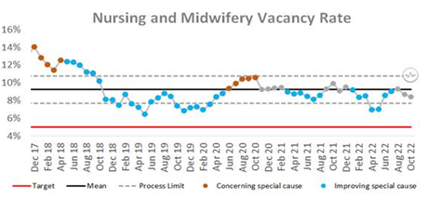
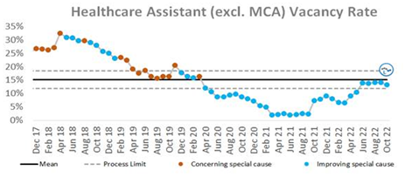
Combined Nursing and Midwifery Staffing Position Vacancy Rates
Graph 1. Nursing and midwifery vacancy rates
Vacancy position
The combined vacancy rate for Registered Nurses (RNs) and Registered Midwives (RMs) has decreased slightly in October to 8.5% from 8.7% in September. The vacancy rate for Health care support workers (HCSWs) (including Maternity Care Assistants (MCAs) has also decreased to 13.5% from 14.4% in September. When broken down further into Nursing and Midwifery specific vacancies, the MCA workforce vacancy rate has increased from 13.2% in September to 16.3% in October. Conversely, the HCSW vacancy rate (excl MCA) has decreased slightly to 13.3% from 14.1% in September.
The HCSW (including MCAs) turnover rate remains high at 18.5% compared to 19.1% in September. The main reason for HCSWs leaving remains voluntary resignation – relocation (29.2%) and the next highest reason is voluntary resignation – work life balance (24.8%). The leavers destination is unknown for the majority of HCSWs (48.2%), 15.5% of HCSW’s are leaving to take up employment in other NHS organisations and 14.2% are leaving for no employment.
Graph 2. Healthcare Assistant vacancy rates

Slide 4
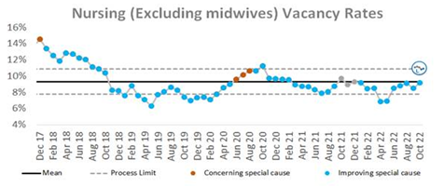
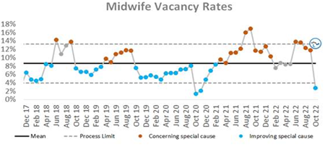
Staffing Position Vacancy Rates for Registered Nurses and Registered Midwives
Graph 3. Registered Nurse vacancy rates
Vacancy position
The vacancy rate for Registered Nurses working in adult areas has increased slightly to 9.2% compared to 8.5% in September. Conversely, the vacancy rate for registered children's nurses has decreased slightly to 21.3% from 22.8% in September.
The vacancy rate for Registered Midwives illustrates a sharp increase in Graph 4 in June however this was due to the work that had been undertaken to align the workforce Electronic Staff Record (ESR) and financial ledger to reflect the additional approved investment in maternity workforce. The actual vacancy rate had remained static for a number of months. Over the last 3 months, there has been a decreasing trend in the vacancy rate from 13.0% in July to 2.8% in October.
The turnover rate in October remains high at 13.6% for RNs in adult areas (14.1% in September), 15.4% for Registered children's nurses (17.6% in September) and 12.6% for RMs (14.4% in September). The main reason for leaving is voluntary resignation – relocation for RNs (50.1%). The main reasons for RMs leaving is voluntary resignation – work life balance (25%) and voluntary resignation – relocation (25%). The leavers destination data demonstrates that 33.3% of RNs and 37.5% of RMs are leaving to take up employment in other NHS organisations. 28.1% of RMs are leaving for no employment compared with 7.2% of RNs.
Graph 4. Registered Midwife vacancy rates

Slide 5
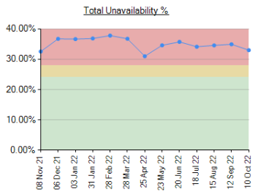
Unavailability for Registered Nurses, Midwives and Health Care Support Workers
Graph 5. Unavailability of staff
Unavailability of staff
Unavailability relates to periods of time where an employee has been given leave from their regular duties. This might be due to circumstances such as annual leave, sick leave, study leave, self isolation, carers leave etc.
The total unavailability of the workforce working time in October has decreased slightly to 29.9% from 31.7% in September as illustrated in Graph 5.
Graph 6 illustrates the percentage breakdown of the type of unavailability. The majority of unavailability (13.5%) was due to planned annual leave which would have been accounted for in the department rosters however there was a high percentage of unplanned leave that would have impacted upon fill rates within the rosters. In October, sickness absence has remained static at 9.3%. Additionally, 1.5% of working time was unavailable due to other leave which is comparable to September (1.5%), 3.5% was due to study leave and 2.1% was due to supernumerary time.
Graph 6. Types of absence

Slide 6
Planned versus actual staffing
Planned versus actual staffing
Graph 7 illustrates trend data for all wards reporting < 90% rota fill. The number of areas reporting <90% rota fill for registered RN/RM has increased in October with 16 areas reporting <90% fill rates compared to 7 in September. There has also been an increase in the number of areas reporting <90% rota fill for HCSWs in October with 22 clinical areas reporting HCSW fill rates of <90% compared with 17 in September. The number of ward areas reporting overall fill rates of <90% in October has also increased to 19 from 9 in September.
All divisions with the exception of Division B reported overall fill rates of <90%. Division E reported the most areas (8) across paediatrics and maternity with overall fill rates of <90%. Appendix 1, details the exception reports for all areas reporting fill rates of <90%.
There has been a significant increase in the number of occasions that 1 critical care nurse has needed to care for more than 1 level 3 patient in October (108 occasions compared to 34 in September). Additionally there have been 165 occasions where there has been no side room co-ordinator (103 in September). This has been due to an increase in the sickness rate and acuity of patients in October compared to September. Any concerns with regards to critical care staffing are escalated through the senior nurse of the day. Staffing has been supported through the use of temporary workers (agency and bank), bank enhancements and registered staff (non critical care trained) are redeployed from the operational pool and clinical areas on a shift by shift basis. Critical care bed capacity remains at 52 beds rather than 59 beds whilst recruitment is ongoing to the vacant positions.
Midwifery & MSW fill rate
Graph 8 illustrates that the overall fill rate for maternity has decreased slightly to 85% compared to 87% in September. The lowest fill rates have been seen on Sara ward (77%).

Slide 7
Staff deployment
Staff deployment
Graph 9 illustrates the movement of staff across wards to support safe staffing to ensure patient safety. This includes staff who are moved on an ad hoc basis (shift by shift) and shows which division they are deployed to.
The number of substantive staff redeployed in October has decreased slightly with an average of 253 working hours being redeployed per day compared with 286 hours in September. This equates to 22 long day or night shifts per day. The majority of redeployments are within division (95.4% compared to 4.6% of staff who are deployed outside of their division). Staffing is also being supported by the operational pool whereby bank staff book a bank shift on the understanding that they will work anywhere in the trust where support is required.
Nursing Pipeline
Appendix 2 provides detail on the forecasted position in relation to the number of adult RN vacancies based on FTE and includes UK experienced, UK newly qualified, apprenticeship route, EU and international recruits up to March 2023. The current forecast demonstrates a year end band 5 RN vacancy position of 9.56% which is above the target of 5%. This is due in part to the reliance on international recruitment and the challenges with accommodation which has impacted upon the numbers of staff that can be deployed each month. A detailed recruitment plan is being collated for all Nursing recruitment pipelines to outline what can realistically be achieved, the blockers that may prevent this and the mitigations that can be put in place to address these.
Appendix 3 provides detail on the forecasted position in relation to the number of Paediatric band 5 RN and HCSW vacancies up to March 2023. Numbers are based on those interviewed and offered positions in addition to planned campaigns. The current forecast demonstrates a year end band 5 Paediatric RN vacancy position of 18.17% and a band 2 HCSW position of 1.2%.
Whilst the recruitment pipeline is positive with multiple pipelines including apprenticeship routes, domestic and international recruitment, the predicted numbers are only achievable if the appropriate infrastructure is in place to support.

Slide 8
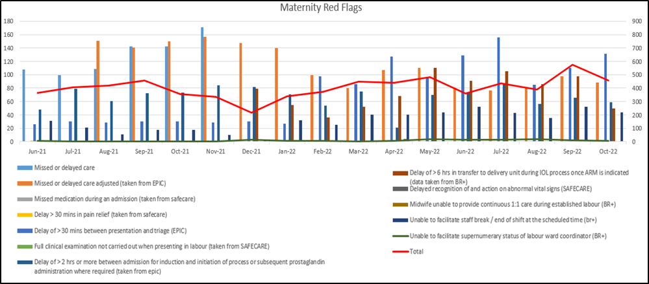
Red flags
Red Flags
A staffing red flag event is a warning sign that something may be wrong with nursing or midwifery staffing. If a staffing red flag event occurs, the registered nurse or midwife in charge of the service should be notified and necessary action taken to resolve the situation.
Nursing red flags
Graph 10 illustrates that the number of red flags reported in October has increased from 137 to 330. The highest number of red flags reported in October was in relation to an unmet 1:1 specialling requirement (175 compared with 52 in September). A trust wide improvement project focusing on specialling is being developed to review specialling across the organisation. Additionally, 76 red flags were reported in relation to an unmet required nursing skills compared with 47 in September.
Graph 11: Maternity Red Flags
Maternity red flags
The number of maternity red flags reported in October has decreased slightly to 457 compared with 575 in September. Graph 11 illustrates the red flags that have been reported. 27.4% of these red flags were due to missed or delayed care, 22.3% were due to a delay of >6hrs in transfer to delivery unit in induction of labour process and 19.9% were due to a delay of >30mins between presentation and triage. This is reflective of the high levels of activity and difficulty in maintaining flow.
.

Slide 9
Safety and Risk
Incidents reported relating to staff shortages
Graph 12 illustrates the trend in Safety Learning Reports (SLRs) completed in relation to nurse staffing. There were 99 incidents reported relating to nurse staffing in October which has increased from the number reported in September (60).
The majority of the incidents related to staffing levels in October were reported by division C (40). Within Division C, the majority of staffing incidents were reported on 3 ward areas (Ward F5 6 incidents, Ward D5 5 incidents and Ward T2 5 incidents). Safety continues to be monitored through the site safety meetings.
Care hours per patient day (CHPPD)
Care hours per patient day (CHPPD) is the total number of hours worked on the roster (clinical staff including AHPs) divided by the bed state captured at 23.59 each day. NHS Improvement began collecting care hours per patient day formally in May 2016 as part of the Carter Programme. All Trusts are required to report this figure externally.
CUH CHPPD recorded for October has remained static at 8.1 which is comparable to the national median of 7.9 however is lower than other Shelford hospitals (9.6).
In maternity, from 1 April 2021, the total number of patients now includes babies in addition to transitional care areas and mothers who are registered as a patient. CHPPD for the delivery unit in October was 11.85 which is slightly lower than September (12.24).
Graph 13: Care Hours Per Patient Day (CHPPD)

Slide 10
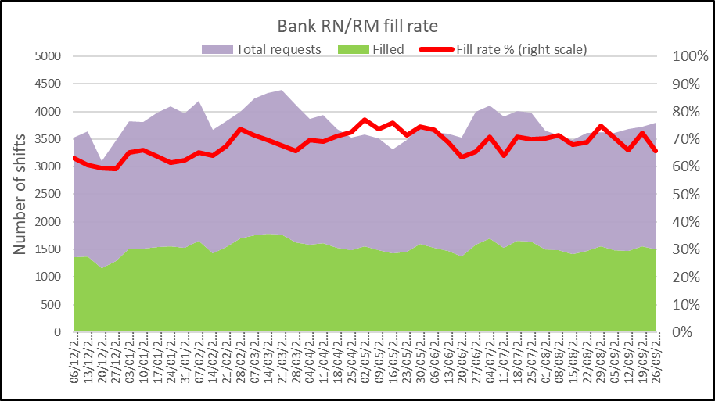
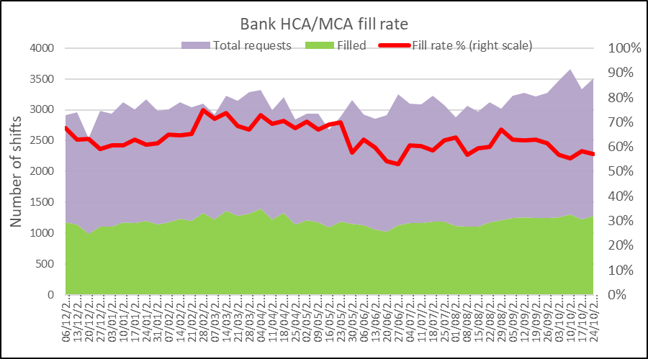
Bank Fill Rate and Agency Usage
Graph 14 Registered RN/RM Bank fill rate per week
Bank fill rate
The Trust’s Staff Bank continues to support the clinical areas with achieving safe staffing levels. Graph 14 and 15 illustrate the trends in bank shift fill rate per week. Overall we have seen an increase in bank shift requests for registered staff over the last 6 months to mitigate those areas who have less than a rota fill of 90%. The number of requests for registered staff is an average of 2307 shifts per week requested and an average bank fill rate of 66.9%.
The number of requests for Health care support workers and Maternity support workers remains high with an average of 2224 shifts per week requested and an average bank fill rate of 56.9%.
In addition to bank workers we have the equivalent of 38.8 WTE agency workers working across the divisions to support staffing challenges in the short term. This accounts for 11% of the total Nursing filled shifts. Of the total proportion of shifts filled through temporary staffing 5% have been filled via agency workers compared with 95% filled via bank workers.
Short term pay enhancements for bank shifts have been put in place in areas where we are looking to encourage a higher uptake of shifts. These bank enhancements are reviewed regularly (at least on a 6 weekly basis) through the weekly bank enhancement meeting and are for fixed periods of time.
Graph 15 HCSW/MSW bank fill rate per week

Slide 11
Appendix 1: Exception report by Division – Division A and C

Slide 12
Appendix 1: Exception report by Division – Division D and E
Division D | % fill registered | % fill care staff | Overall filled % |  | Analysis of gaps | Impact on Quality / outcomes | Actions in place
A3 | 87% | 103% | 91% | 6.28 | Current RN vacancies 3.08 WTE. 1 WTE Band 5 on Supernumerary Period. 1 x Band 6 on Non-clinical as per OH guidance (1.0 WTE), Total Sickness 1.63% for October. 1 x Band 5 on Long Term Sick (0.6WTE) Supervisory Sister time compliance 16% | All key patient safety and quality metrics are being tracked, no escalating impact on reported patient safety incidents. Senior sister is consistently required to support clinical caseload therefore supervisory time required to fulfil role is compromised. Supervisory Sr. time 42% | Oversight attwice daily divisional staffing briefings, Trust Site Safety meetings and monthly nursing workforce/divisional quality goverance forums. Staff Re-deployed from A4 / A5 and C8n to help mitigate. Actively recruiting to vacancies
K3 | 89% | 101% | 94% | 5.71 | Sickness RN 3.2%, HCA 4% Supervisory Sister time compliance 50% | All key patient safety and quality metrics are being tracked, no esculating impact on reported patient safety incidents. Senior sister is consistently required to support clinical caseload therefore supervisory time required to fulfil role is compromised. Supervisory Sr. time 42% | Oversight at twice daily divisional staffing briefings, Trust Site Safety meetings and monthly nursing workforce/divisional quality governance forums
Division E | % fill registered | % fill care staff | Overall filled % | CHPPD | Analysis of gaps | Impact on Quality / outcomes | Actions in place
C2 | 86% | 91% | 87% | 9.69 | Current shortfall of 12.26 WTE RN vacancy and 2.6 HCSW, 7 RN pipeline in. 0 WTE pipeline out. This is inclusive of staffing for the 2 extra beds that are not open which equates to 5WTE. | no impact on NQM ,patient experience feedback. Impact on staff wellbeing as reported by senior team. Skill concerns due to chemotherapy competence. | Currently utilising agency nurses with paediatric training. Three times review a day of occupancy and staffing. Support from CPFand PD , CPF supported to be supernumary to support new starters. Rate 3 for all staff. New starters commencing in October and November.
F3 COU | 85% | 100% | 89% | 6.36 | Current shortfall of 8.6 WTE RN vacancy and 2.3 HCSW, 4 WTE pipeline in. 2.4 WTE pipeline out. | Positive patient experience feedback. Minimal delays to theatre starts related to staffing. Starting 24/7 opening from December. | Three times review a day of occupancy and staffing. Rate 3 for all staff. Support from unit when possible.
PICU | 78% | 106% | 82% | 24.79 | Current shortfall of 18.7 WTE RN vacancy , 8.4 WTE pipeline in. 0.7 WTE pipeline out. | increased pressure on QIS staff to support junior team. Positive patient experience feedback. Challenges with practice development due to PICU course and sickness.Development days continue. Psychological support for team maintained with plan to increase psychology in PICU. | Three times review a day of occupancy and staffing. Rate 3 for all staff. Plan for support from the ODN to support repatriation , band 5 -6 bridging the gap development resulted in offers to 6 new band 6's.
Delivery Unit | 82% | 76% | 80% | 11.85 | Still some vacancy rate but projected 2.08% next month across the service which will improve overall fill rate | can cause delays to continuation of IOL and delays to starting the process | Recruitment and retention strategy continues, aspirant band 7 coordinator programme in place to start in January 2023
Lady Mary | 86% | 86% | 86% | 3.89 | Still some vacancy rate but projected 2.08% next month across the service which will improve overall fill rate | Delays with discharges and can also lead to complaints about timeliness of support with infant feedig and pain relief management | Long term plan for exploring nursing staff to support ward
Rosie Birth Centre | 82% | 80% | 82% | 11.95 | Still some vacancy rate but projected 2.08% next month across the service which will improve overall fill rate | May need to close bircth centre due to staffing challenges, which impacts on womens choice of place of birth | to increase staffing establishment to improve flex across the service
Sara Ward | 77% | 77% | 77% | 4.83 | Still some vacancy rate but projected 2.08% next month across the service which will improve overall fill rate | Main impact on inductions of labour, delays to starting and progressing | Recritment strategy in progress
Neonatal ICU | 87% | 65% | 85% | 12.80 | Current shortfall of 15.8 WTE RN vacancy and 7.4 HCSW, 7.7 RN awaiting PIN or pipeline. 2.8 WTE pipeline out. | no impact on NQM ,patient experience feedback. Impact on staff wellbeing as reported by senior team. Not compliant with BAPM standards at times of high acuity and occupancy. | Three times review a day of occupancy and staffing. Support from CPF and PD and support staff. Rate 3 for all staff. New starters commencing in October and November.

Slide 13
Appendix 2: Adult RN Recruitment pipeline
Adult band 5 RN position based on predictions and established FTE
Month | UK based exp. applicants | Anglia Ruskin NQ (60% of graduates) | Other NQ | NAP | Return to Practice | Overseas | Total New Starters | Leavers FTE | Promotions and transfer out of scope- retained by the trust | Staff in post FTE | ESR Establishment FTE | Vacancy rate based on established FTE | No. of vacancies based on established FTE | Starter leaver variance
Apr-22 | 7 |  |  |  |  | 25 | 32 | 15 | 14 | 1584 | 1768 | 10.41% | 184.12 | 17
May-22 | 8 |  |  | 17 |  | 20 | 45 | 25 | 7 | 1597 | 1768 | 9.67% | 171 | 20
Jun-22 | 1 |  |  |  |  | 23 | 24 | 14.4 | 13 | 1594 | 1768 | 9.86% | 174.4 | 9.6
Jul-22 | 6 |  |  | 9 |  | 29 | 44 | 24 | 14 | 1600 | 1768 | 9.52% | 168.4 | 20
Aug-22 | 5.2 |  | 0.45 |  |  | 23 | 29 | 22.6 | 4 | 1591 | 1699 | 6.33% | 107.47 | 6.05
Sep-22 | 3 | 1 |  | 0 |  | 22 | 26 | 18 | 14 | 1585 | 1699 | 6.68% | 113.47 | 8
Oct-22 | 3 | 2 | 6 |  |  | 12 | 23 | 19 | 13 | 1576 | 1699 | 7.21% | 122.47 | 4
Nov-22 | 3 | 6 |  |  |  | 13 | 22 | 18 | 14 | 1566 | 1699 | 7.80% | 132.47 | 4
Dec-22 | 5 |  |  |  |  | 8 | 13 | 18 | 15 | 1546 | 1699 | 8.97% | 152.47 | -5
Jan-23 | 1 |  |  | 32 |  | 5 | 38 | 18 | 15 | 1551 | 1699 | 8.68% | 147.47 | 20
Feb-23 | 6 |  |  |  |  | 15 | 21 | 18 | 15 | 1539 | 1699 | 9.39% | 159.47 | 3
Mar-23 | 5 | 5 | 5 |  |  | 15 | 30 | 18 | 15 | 1536 | 1699 | 9.56% | 162.47 | 12
TOTAL | 53 | 14 | 11 | 58 | 0 | 210 | 347 | 228 | 153 | 1536 | 1698.95 | 9.56% | 162.47 | 118.65

Slide 14
Appendix 3: Paediatric RN and Band 2 HCSW Recruitment pipeline
Paediatric band 5 RN position based on predictions and established FTE
Month | UK based exp. applicants | Anglia Ruskin NQ | Other NQ | NAP | Overseas | Total New Starters FTE | Leavers FTE (based on leavers in the last 12 months) | Promotions and transfer out of scope- retained by the trust | Staff in post FTE | ESR Establishment FTE | Vacancy rate based on established FTE | No. of vacancies based on established FTE | Starter leaver variance
Apr-22 | 2 |  |  |  |  | 2 | 1 | 2 | 187.42 | 284.41 | 34.10% | 96.99 | 1
May-22 |  |  |  |  | 5 | 5 | 8 | 1 | 183.42 | 284.41 | 35.51% | 100.99 | -3
Jun-22 | 1 |  |  |  | 0 | 1 |  | 1 | 183.42 | 284.41 | 35.51% | 100.99 | 1
Jul-22 | 1 |  | 1 |  | 1 | 3 | 2 | 1 | 183.42 | 284.41 | 35.51% | 100.99 | 1
Aug-22 |  |  | 1 |  | 3 | 4 | 2 | 2 | 170.89 | 213.73 | 20.04% | 42.84 | 2.47
Sep-22 | 1 |  | 1 |  | 0 | 2 | 2 | 1 | 170 | 213.73 | 20.51% | 43.84 | 0
Oct-22 | 2 | 3 | 4 |  | 6 | 15 | 5 | 0 | 180 | 213.73 | 15.83% | 33.84 | 10
Nov-22 | 1 | 8 | 2 |  | 1 | 12 | 5 | 3 | 184 | 213.73 | 13.96% | 29.84 | 7
Dec-22 |  | 1 |  |  | 1 | 2 | 6 | 1 | 179 | 213.73 | 16.30% | 34.84 | -4
Jan-23 |  |  | 1 |  | 1 | 2 | 4 | 1 | 176 | 213.73 | 17.70% | 37.84 | -2
Feb-23 | 2 |  |  |  | 1 | 3 | 2 | 1 | 176 | 213.73 | 17.70% | 37.84 | 1
Mar-23 | 2 |  |  |  | 1 | 3 | 3 | 1 | 175 | 213.73 | 18.17% | 38.84 | 0
TOTAL | 12 | 12 | 10 | 0 | 20 | 54 | 39.53 | 15 | 174.89 | 213.73 | 18.17% | 38.84 | 14.47
Band 2 HCSW position based on predictions and established FTE
Month | UK based applicants | Apprenticeship (direct entry) | Total New Starters FTE | Leavers FTE | Staff in post FTE | ESR Establishment FTE | Vacancy rate based on established FTE | No. of vacancies based on established FTE
Apr-22 | 15 |  | 15 | 16 | 812 | 947 | 14.3% | 135
May-22 | 17 |  | 17 | 21 | 808 | 970 | 16.7% | 162
Jun-22 | 27.8 |  | 27.8 | 13 | 823 | 970 | 15.2% | 148
Jul-22 | 21 |  | 21 | 16 | 828 | 970 | 14.7% | 143
Aug-22 | 18 | 8 | 26 | 2 | 745 | 855 | 12.9% | 110
Sep-22 | 17 | 4 | 21 | 11 | 755 | 855 | 11.7% | 100
Oct-22 | 20 | 9 | 29 | 14 | 770 | 855 | 10.0% | 85
Nov-22 | 30 |  | 30 | 20 | 780 | 855 | 8.8% | 75
Dec-22 | 15 |  | 15 | 15 | 780 | 855 | 8.8% | 75
Jan-23 | 25 |  | 25 | 20 | 785 | 855 | 8.2% | 70
Feb-23 | 25 |  | 25 | 15 | 795 | 855 | 7.0% | 60
Mar-23 | 25 | 40 | 65 | 15 | 845 | 855 | 1.2% | 10
TOTAL | 255.8 | 61 | 316.8 | 178 | 845 | 855 | 1.2% | 10

